Slide 1
Stochastic simulations of classical PDEs with non-trivial boundary conditions
Magnus Ögren
School of Science and Technology
Örebro University, Sweden

Slide 2
Why did I start with this research…
Background:

Slide 3
Why did I start with this research…
Given a task (from funder!):
Understand properties of large rocks from small samples…
Data from synchrotron radiation facilities.

Slide 5
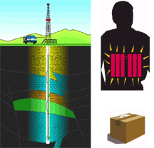
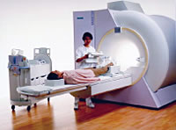
Nuclear Magnetic Resonance
NMR important tool in modern technology.

Slide 6
After simplifications of Bloch’s equations for NMR dynamics, we are left with a reaction-diffusion equation with Robin boundary conditions

Slide 7
We integrate out the spatial degrees to obtain a time-dependent total magnetization
For uniform initial conditions, Gauss’ theorem can provide the short time asymptote

Slide 9
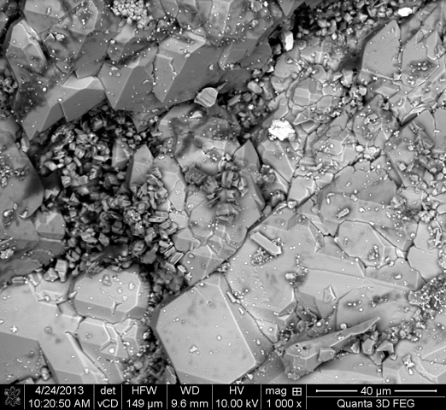
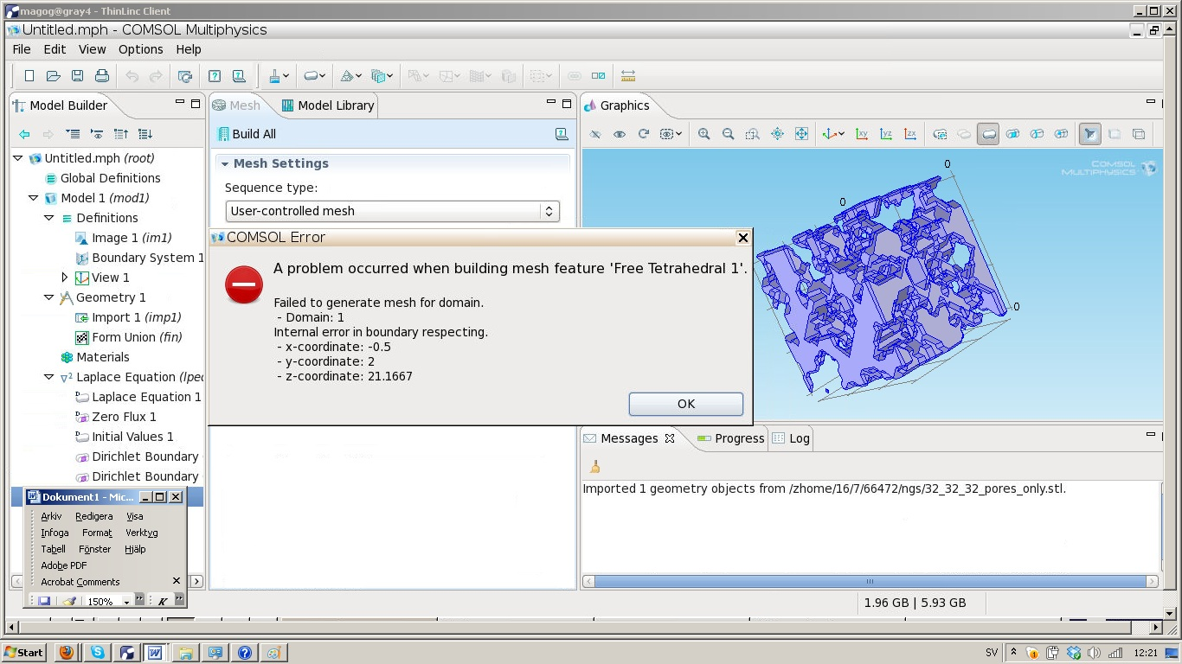
In many applications the domain
can be problematic…

Slide 10
Try a random approach!

Slide 11
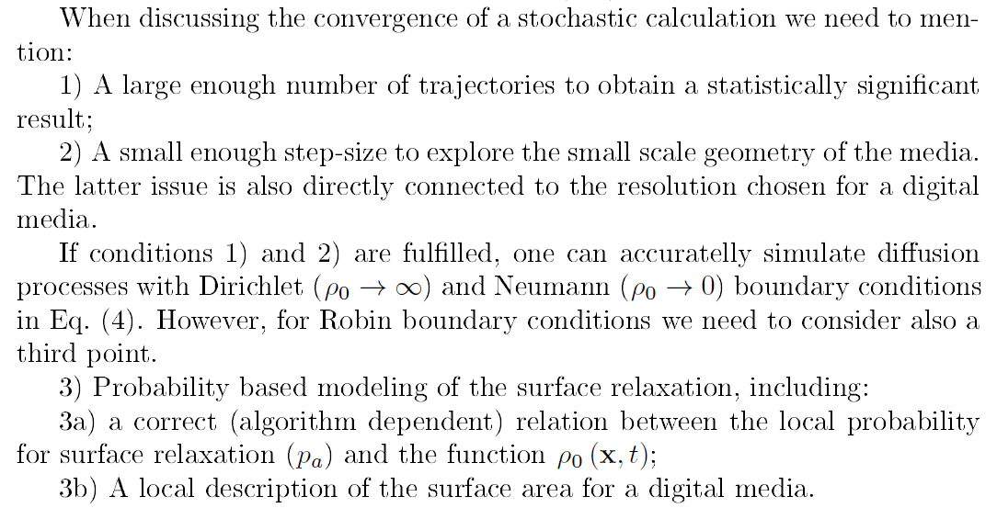

Slide 12
3a) We have derived (first order) relation between parameters in PDE model and the RWM:
3b) We have constructed (first order) local boundary conditions that can be calculated “on the fly”:
Above illustrated in 2D, generalized to any dimension.

Slide 13
In 2D the effects of ‘digitalization’ is easy to illustrate and quantify:

Slide 14
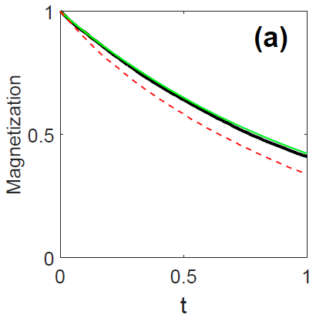
Comparative FEM simulations in 2D.

Slide 15
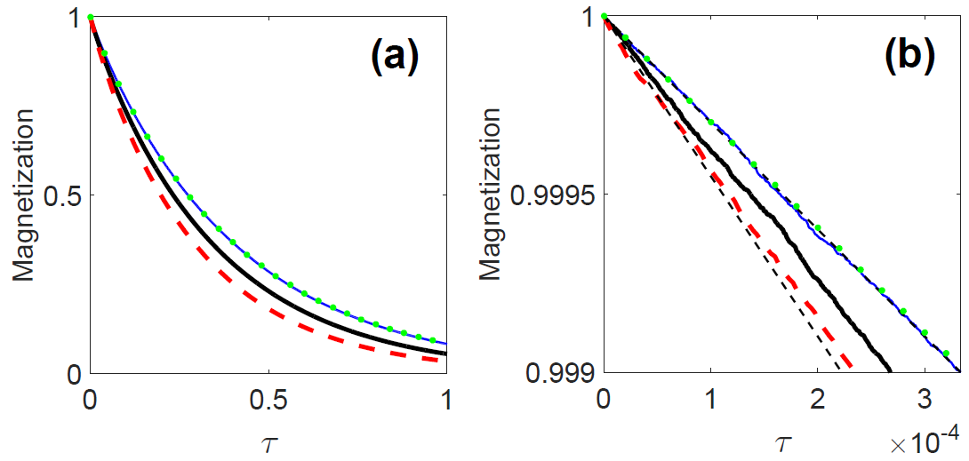
Comparison with analytic formulae: Ball

Slide 16
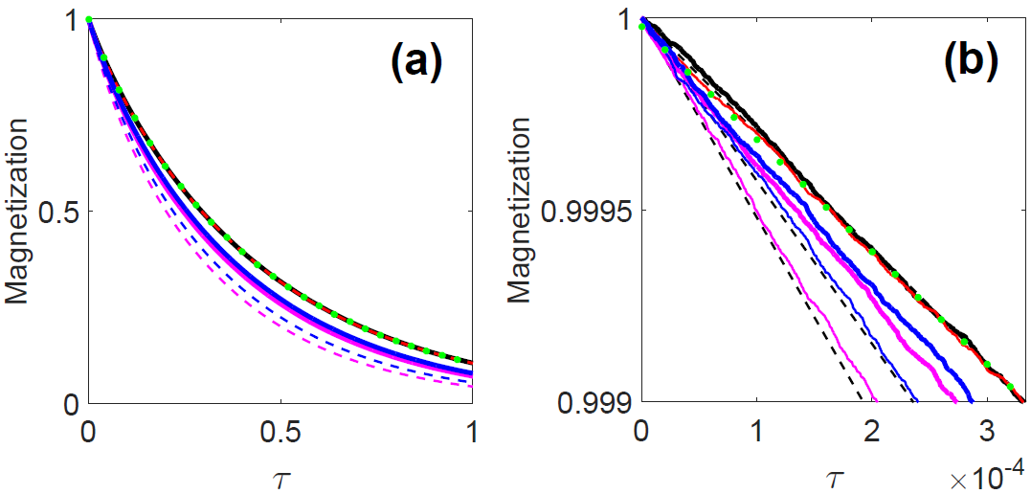
Comparison with analytic formulae: Cube

Slide 17
Simulations on 3D tomography images of chalk with a size in the order of 10³×10³×10³ voxels and resolution 10 nm

Slide 19
Stefan-problem

Slide 20
Stefan-problem

Slide 21
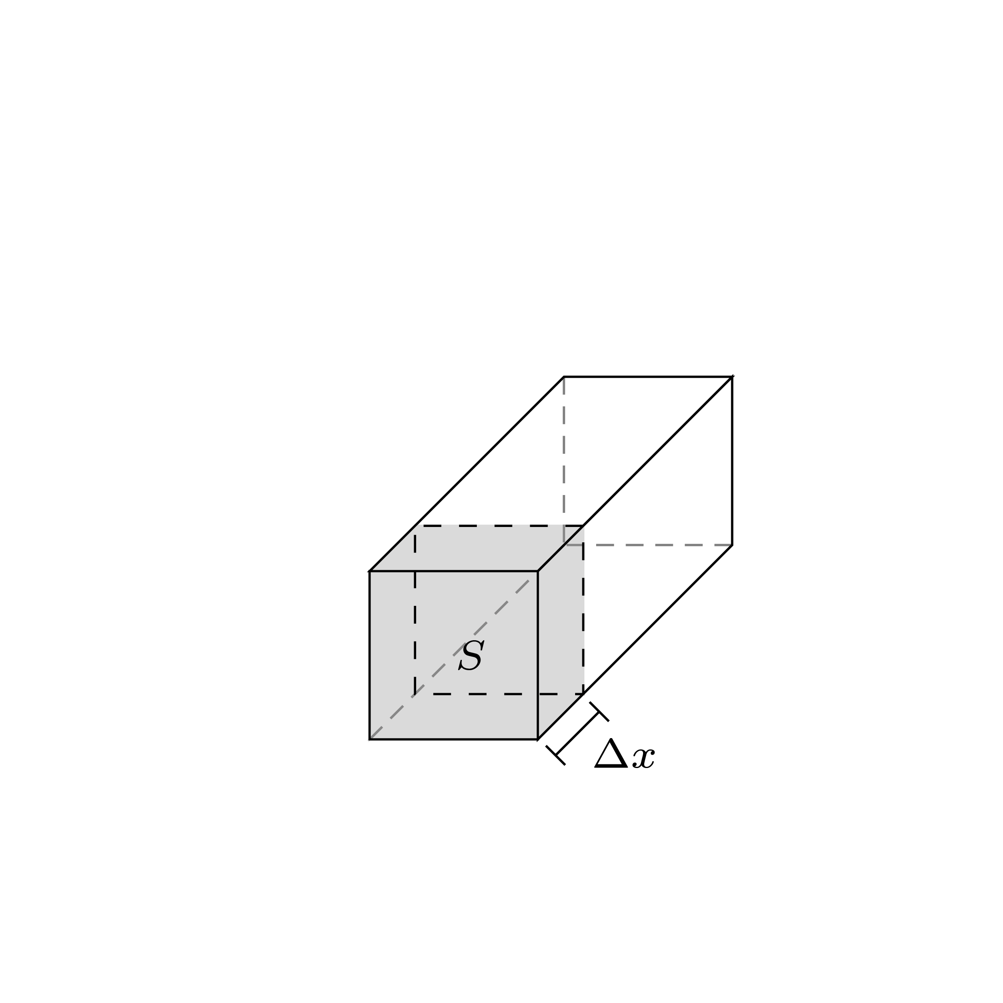
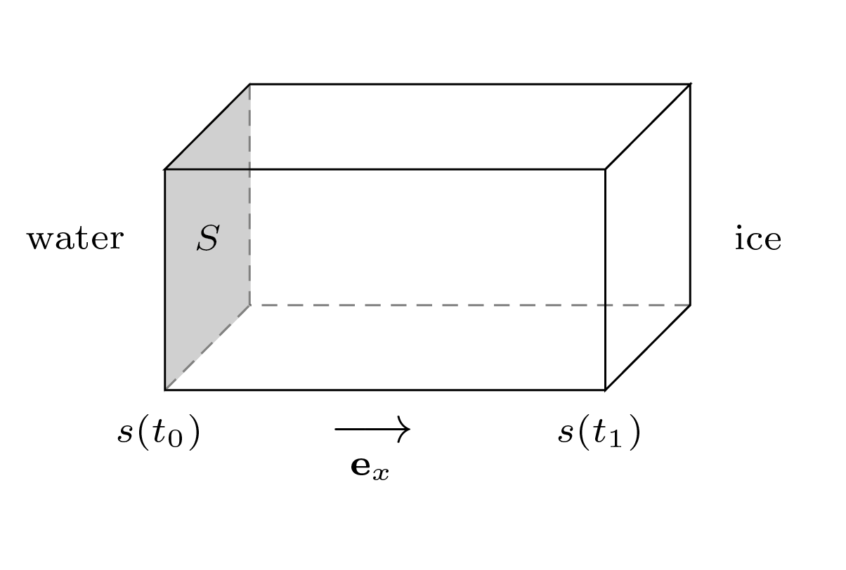
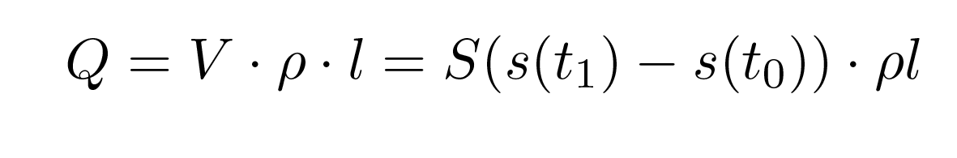
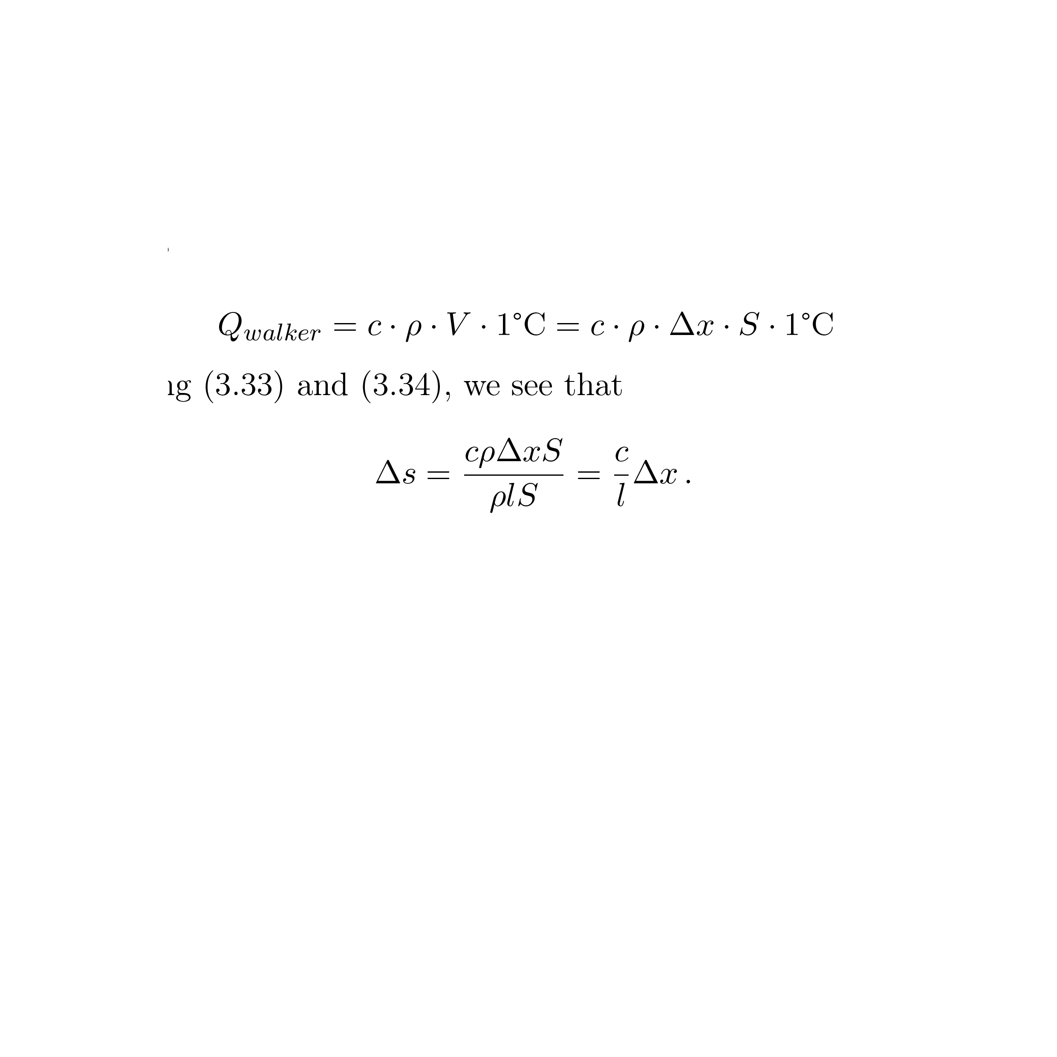
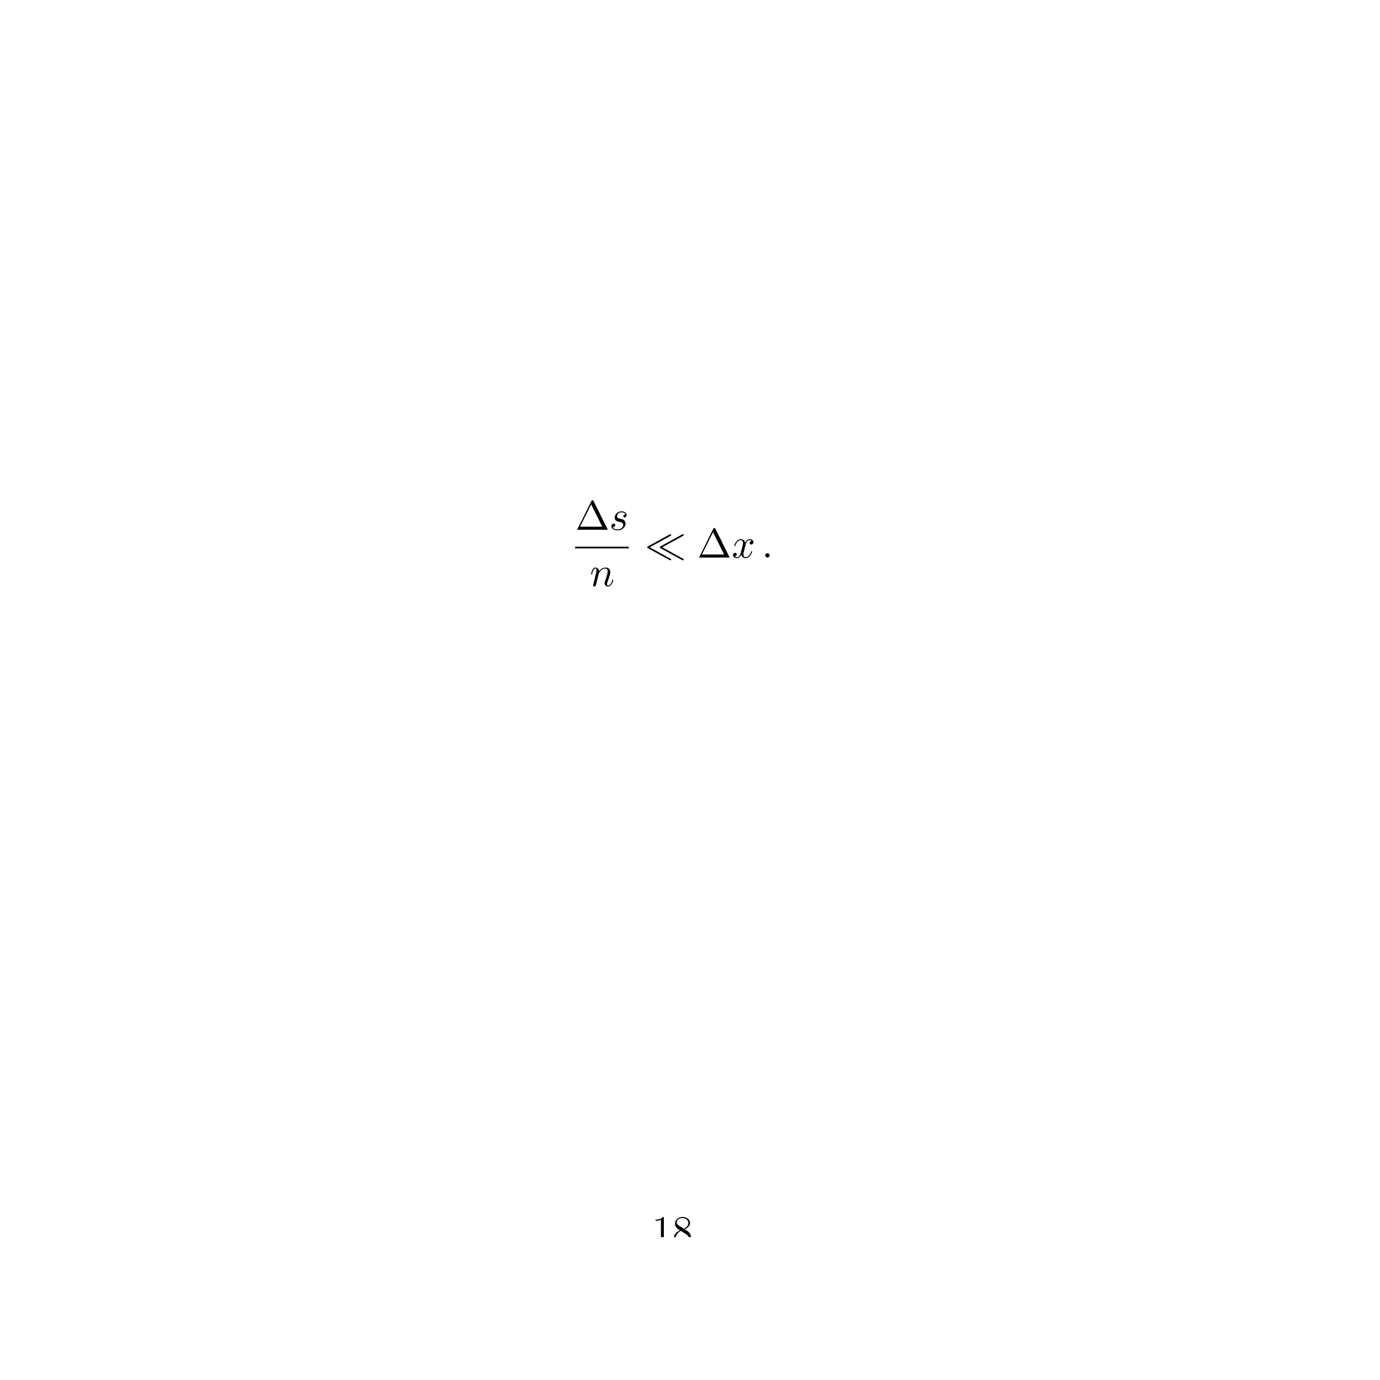
Modelling of the moving boundary
Stefan-problem
Each walker carries an amount of heat that moves the boundary a step ∆s.

Slide 22
Stefan-problem

Slide 23
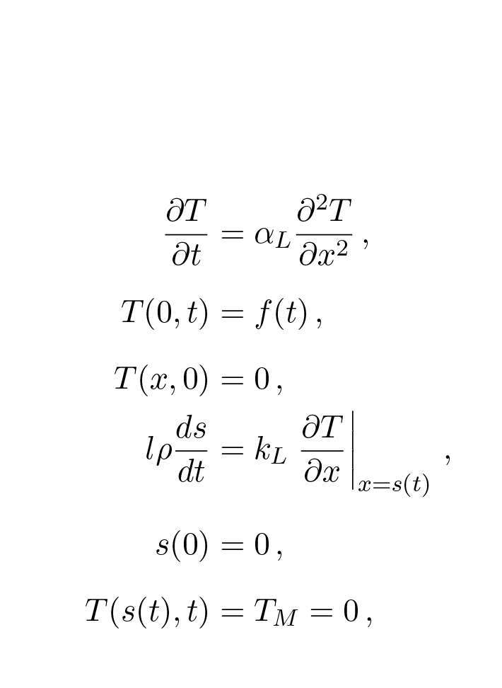
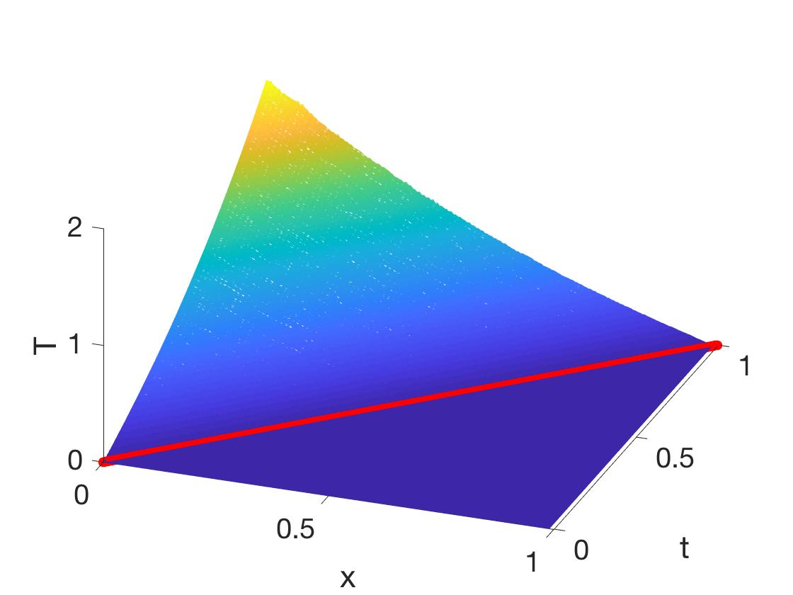
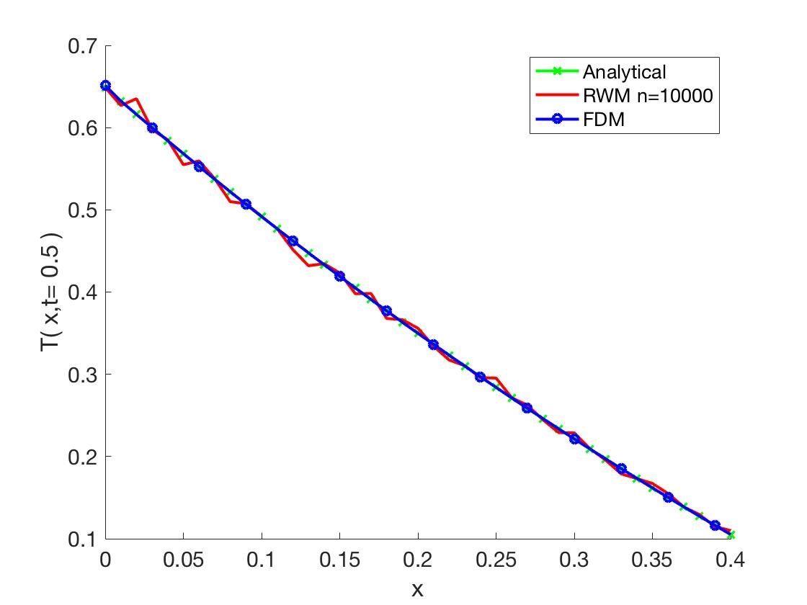
Results for BC: e^t-1
Stefan-problem
e^t-1

Slide 24
Stefan-problem

Slide 25
Thank you!
Interested to read more:
Ögren, M. (2014). Local boundary conditions for NMR-relaxation in digitized porous media. The European Physical Journal B, 87 (11), 255. (arXiv:1312.6581)
Ögren, M. , Jha, D. , Dobberschütz, S. , Müter, D. , Carlsson, M. , Gulliksson, M. , Stipp, S. & Sørensen, H. (2019). Numerical simulations of NMR relaxation in chalk using local Robin boundary conditions.
Journal of magnetic resonance, 308. (arXiv:1909.09618)
A random walk method for the heat equation with moving boundary.
Andreas Lockby, Bachelor thesis 2016:
http://oru.diva-portal.org/smash/record.jsf?pid=diva2%3A935914&dswid=3345
Solution of the Stefan problem with general time-dependent boundary conditions using a random walk method. Daniel Stoor, Bachelor thesis 2019:
http://uu.diva-portal.org/smash/record.jsf?pid=diva2%3A1325632&dswid=-6545

