Slide 1
A deterministic talk(?) about stochastic calculations in classical and quantum physics
Magnus Ögren
School of Science and Technology
Örebro University, Sweden

Slide 2
Abstract:
In this personal overview talk I will introduce some applications of stochastic differential equations I have used, introduced, and improved, in my research in the last 15 years. It started in Brisbane, Australia, where I implemented (suggested by my supervisor) the first calculation for many-particle quantum dynamics with the so called Gaussian Phase-Space Representation (GPSR) [1,2].
Then I had a (2.nd) postdoc in Copenhagen, Denmark, actually during my first postdoc there I met Fatkhulla Abdullaev in Copenhagen in 2011! But during this second postdoc I was confronted with diffusion problems in classical physics where the computational domain where large and complicated 3D porous media from STM images of rock-samples (funded by the oil industry…). I then realized that I could apply some of the methods I had used in the quantum problem, while some techniques on boundary conditions needed to be developed [3,4]. During more recent years, after coming back more to research after heavy teaching duties, I have returned to those kinds of problems in Örebro, Sweden, where both Fatkhulla and Jasur Yuldashev have been. The new research has especially been along the following three avenues: 1) The classical Stefan problem for heat conduction with a moving ice-/water-interface [5,6]; 2) Implementing fermionic-Truncated-Wigner-Approximation (fTWA), with postdoc Francois Rousse [7], interrupted by covid [8]; 3) Attacking the fundamental problem with GPSR, to extend its applicability to more problems in quantum dynamics, by introducing so called matrix-equation-based diffusion gauges [9].

Slide 3
Articles classical :
Ögren, M. (2014). Local boundary conditions for NMR-relaxation in digitized porous media.
The European Physical Journal B, 87 (11), 255. (arXiv:1312.6581)
Ögren, M., Jha, D., Dobberschütz, S., Müter, D., Carlsson, M., Gulliksson, M., Stipp, S. & Sørensen, H. (2019). Numerical simulations of NMR relaxation in chalk using local Robin boundary conditions.
Journal of magnetic resonance, 308. (arXiv:1909.09618)
Book chapter: Ögren, M., Stochastic Solutions of Stefan Problems with General Time-Dependent Boundary Conditions. In: Malyarenko, A., Ni, Y., Rancic, M., Silvestrov, S. (eds) Stochastic Processes, Statistical Methods, and Engineering Mathematics . SPAS 2019. Springer Proceedings in Mathematics & Statistics, vol 408. Springer, Cham. (https://doi.org/10.1007/978-3-031-17820-7_29), (arXiv:2006.04939 [math.AP]).
The role of super-spreaders in modeling of SARS-CoV-2, F Rousse, M Carlsson, M Ogren, B K.-Wellander
Infectious Disease Modelling 7 (2022) 778-794
https://arxiv.org/abs/2212.04545
Random walks and moving boundaries: Estimating the penetration of diffusants into dense rubbers
Authors: Surendra Nepal, Magnus Ogren, Yosief Wondmagegne, Adrian Muntean
Probabilistic Engineering Mechanics 74 (2023) 103546,
arXiv:2305.08520 [pdf, other] math.NA math.PR
In progress: Edström D., Ögren, M., Budaev B. (2024?). Stochastic solutions of multi-phase Stefan problems.
In the future?: Applications with directly calculated gradients, electric currents, liquid flows.

Slide 4
Articles Quantum problems:
[1] First-principles quantum dynamics for fermions: Application to molecular dissociation,
M. Ogren, K. V. Kheruntsyan, J. F. Corney
Europhys. Lett., 92 (2010) 36003
https://arxiv.org/abs/0910.4440
[2] Stochastic simulations of fermionic dynamics with phase-space representations,
M. Ogren, K. V. Kheruntsyan, J. F. Corney
Comp. Phys. Comm. 182, 1999 (2011)
https://arxiv.org/abs/1008.0970
[7] Correlated quantum dynamics of graphene,
F. Rousse, O. Eriksson, M. Ogren
Phys. Rev. B 107, 134306 (2023)
https://arxiv.org/abs/2212.04352
[9] Simulations of quantum dynamics with fermionic phase-space representations using numerical matrix factorizations as stochastic gauges,
F Rousse, M Fasi, A Dmytryshyn, M Gulliksson, M Ogren
J. Phys. A: Math. Theor. 57 (2024) 015303
https://arxiv.org/abs/2304.05149

Slide 5
Why did I start with this Quantum research…
Background:

Slide 7
Why did I start with this Classical research…
Given a task (from funder!):
Understand properties of large rocks from small samples…
Data from synchrotron radiation facilities.

Slide 9
Moving boundaries….

Slide 10
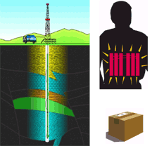
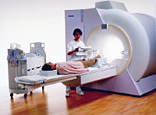
Nuclear Magnetic Resonance
NMR important tool in modern technology.

Slide 11
After simplifications of Bloch’s equations for NMR dynamics, we are left with a reaction-diffusion equation with Robin boundary conditions

Slide 12
We integrate out the spatial degrees to obtain a time-dependent total magnetization
For uniform initial conditions, Gauss’ theorem can provide the short time asymptote

Slide 14
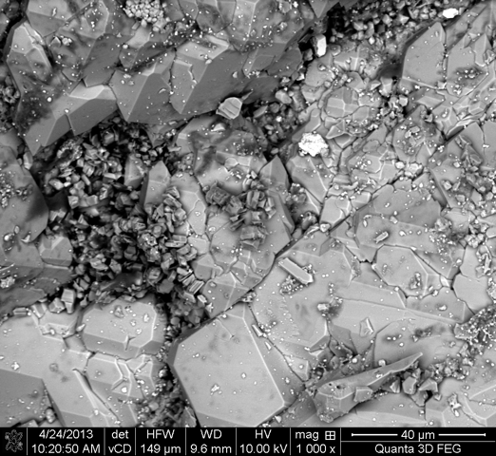
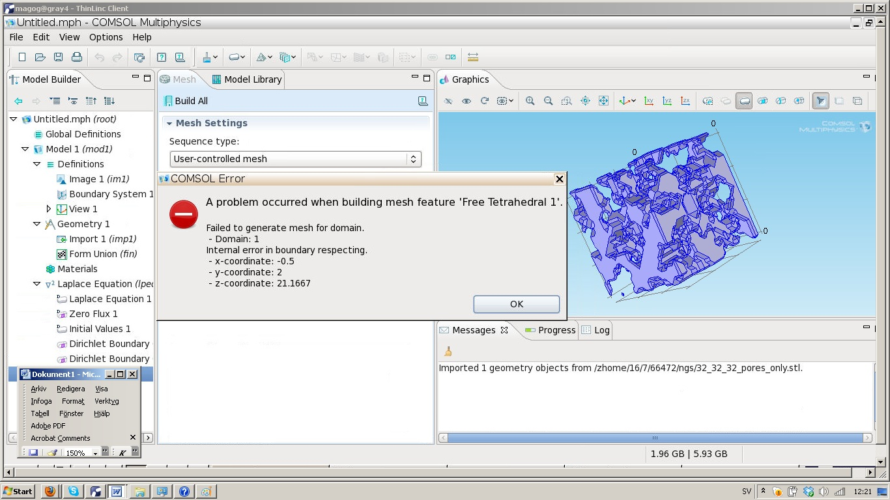
In many applications the domain
can be problematic…

Slide 15
Try a random approach!

Slide 16
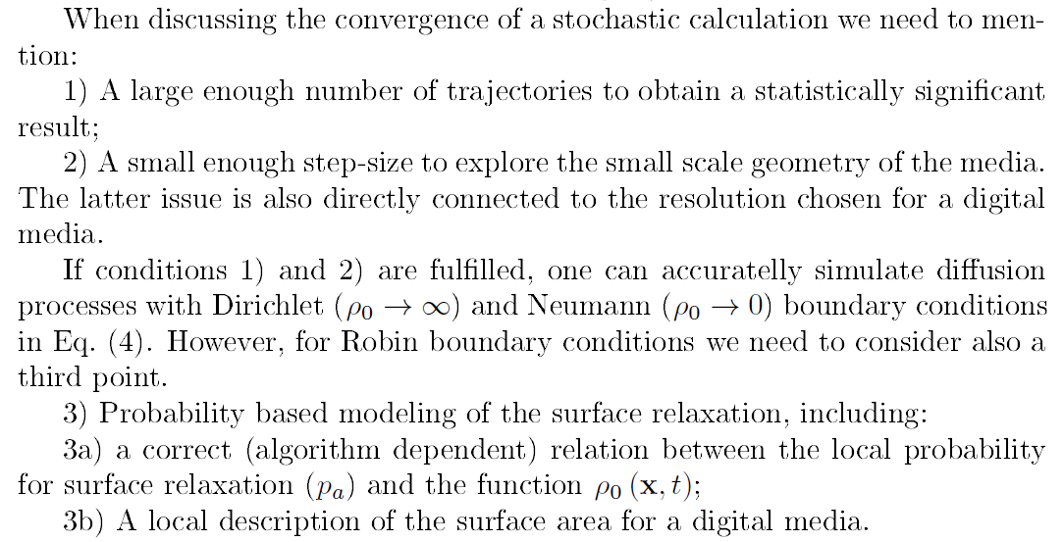

Slide 17
3a) We have derived (first order) relation between parameters in PDE model and the RWM:
3b) We have constructed (first order) local boundary conditions that can be calculated “on the fly”:
Above illustrated in 2D, generalized to any dimension.

Slide 18
In 2D the effects of ‘digitalization’ is easy to illustrate and quantify:

Slide 19
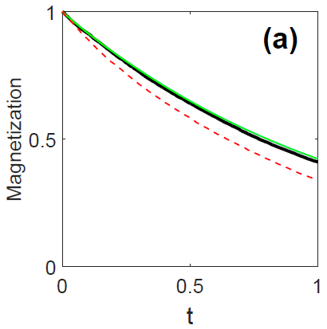
Comparative FEM simulations in 2D.

Slide 20
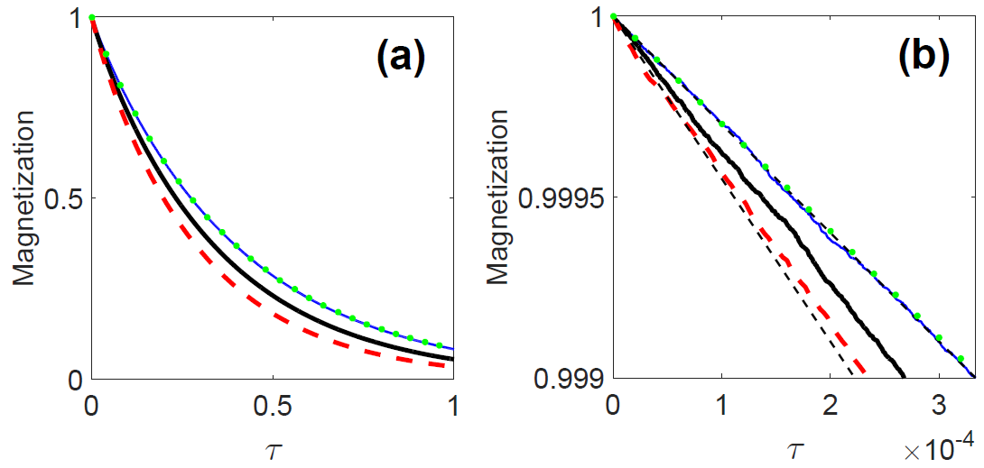
Comparison with analytic formulae: Ball

Slide 21
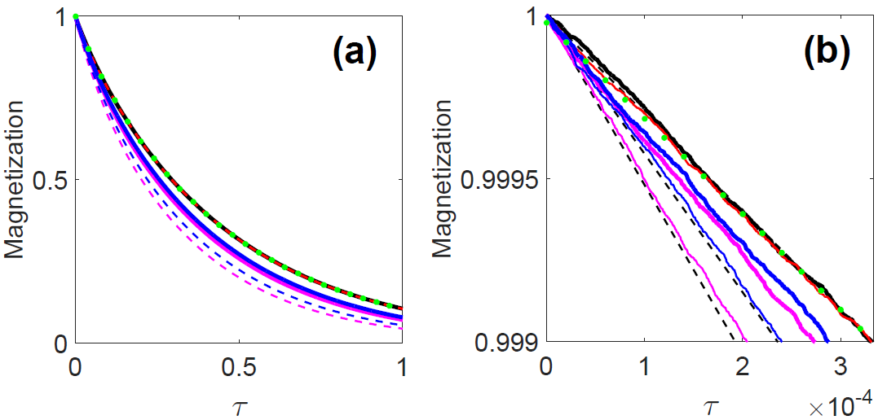
Comparison with analytic formulae: Cube

Slide 22
Simulations on 3D tomography images of chalk with a size in the order of 10³×10³×10³ voxels and resolution 10 nm

Slide 24
Electric currents….

Slide 25
Electric currents….

Slide 26
Electric currents….

Slide 27
Electric currents….

Slide 28
Electric currents….

Slide 29
The Stefan problem

Slide 30
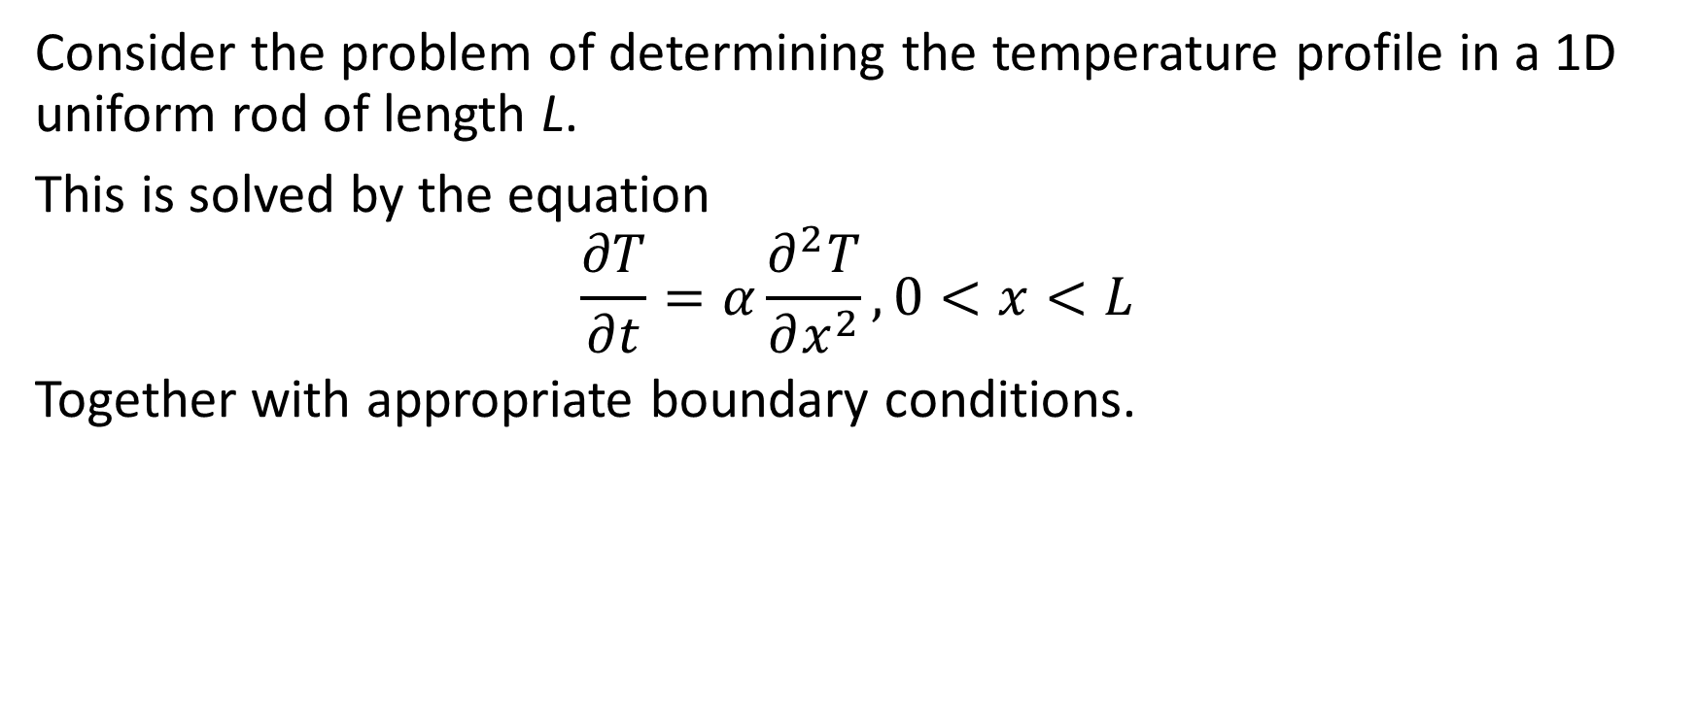
The heat equation
Consider the problem of determining the temperature profile in a 1D uniform rod of length L.
This is solved by the equation
$$\frac{∂T}{∂t}=α\frac{∂^{2}T}{∂x^{2}}, 0<x<L$$
Together with appropriate boundary conditions.
L

Slide 31
The one-phase Stefan problem
Now consider a 1D rod of ice with an imposed temperature at one end. As the ice melts, water is formed and a moving boundary s(t) between water and ice is created.
This is the Stefan Problem.
s(t)
L

Slide 32
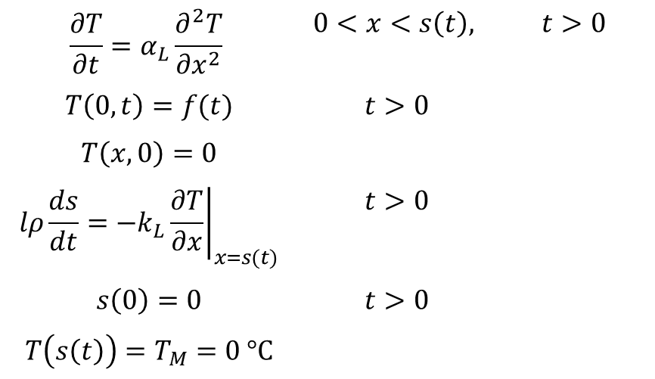
The one-phase Stefan problem
$$\frac{∂T}{∂t}=α_{L}\frac{∂^{2}T}{∂x^{2}}$$ | $$0<x<s\left(t\right),$$ | $$t>0$$
$$T\left(0,t\right)=f(t)$$ | $$t>0$$
$$T\left(x,0\right)=0$$
$$lρ\frac{ds}{dt}=−k_{L}{\left.\frac{∂T}{∂x}\right|}_{x=s(t)}$$ | $$t>0$$
$$s\left(0\right)=0$$ | $$t>0$$
$$T\left(s\left(t\right)\right)=T_{M}=0 °C$$

Slide 33
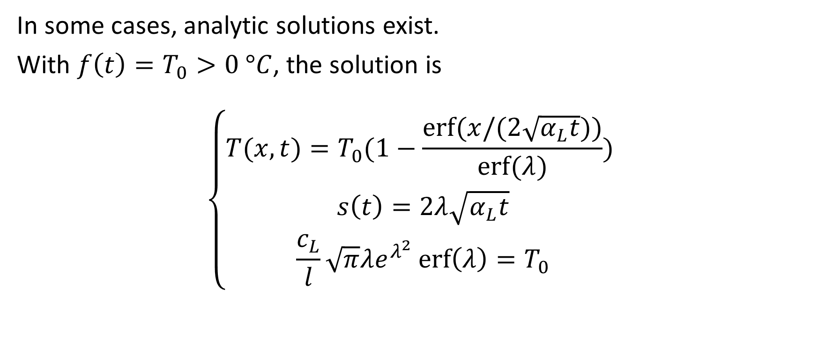
The one-phase Stefan problem
In some cases, analytic solutions exist.
With $f\left(t\right)=T_{0}>0 °C$, the solution is
$$\left\{\begin{aligned}T(x,t)=T_{0}(1−\frac{erf⁡(x/(2\sqrt{α_{L}t}))}{erf⁡(λ)}) \\ s\left(t\right)=2λ\sqrt{α_{L}t} \\ \frac{c_{L}}{l}\sqrt{π}λe^{λ^{2}}\operatorname{erf}\left(λ\right)=T_{0}\end{aligned}\right.$$

Slide 34
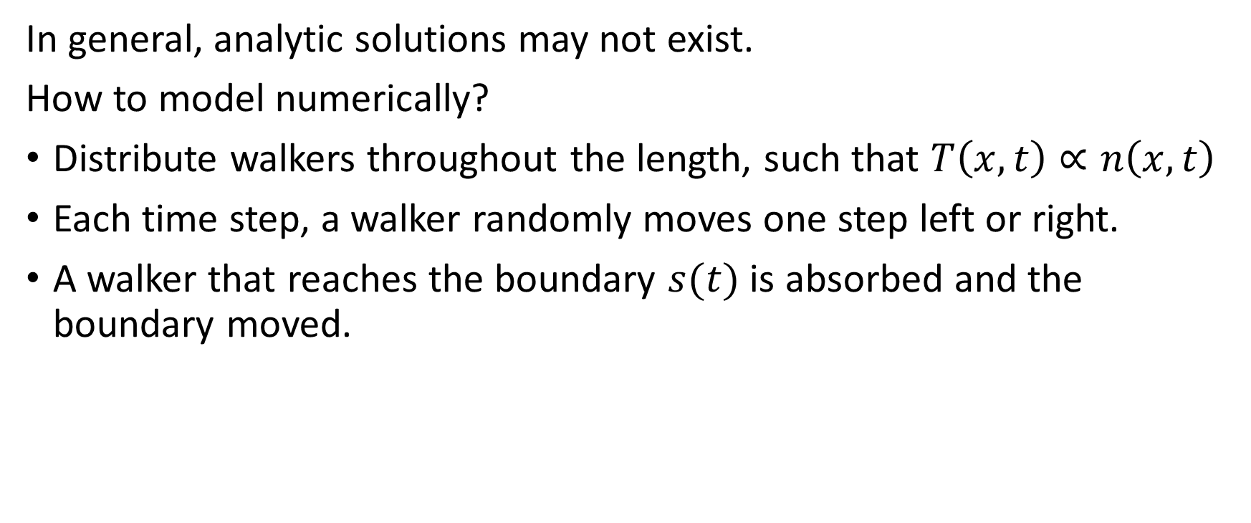
The one-phase Stefan problem
In general, analytic solutions may not exist.
How to model numerically?
Distribute walkers throughout the length, such that $T\left(x,t\right)∝n\left(x,t\right)$
Each time step, a walker randomly moves one step left or right.
A walker that reaches the boundary $s(t)$ is absorbed and the boundary moved.

Slide 35
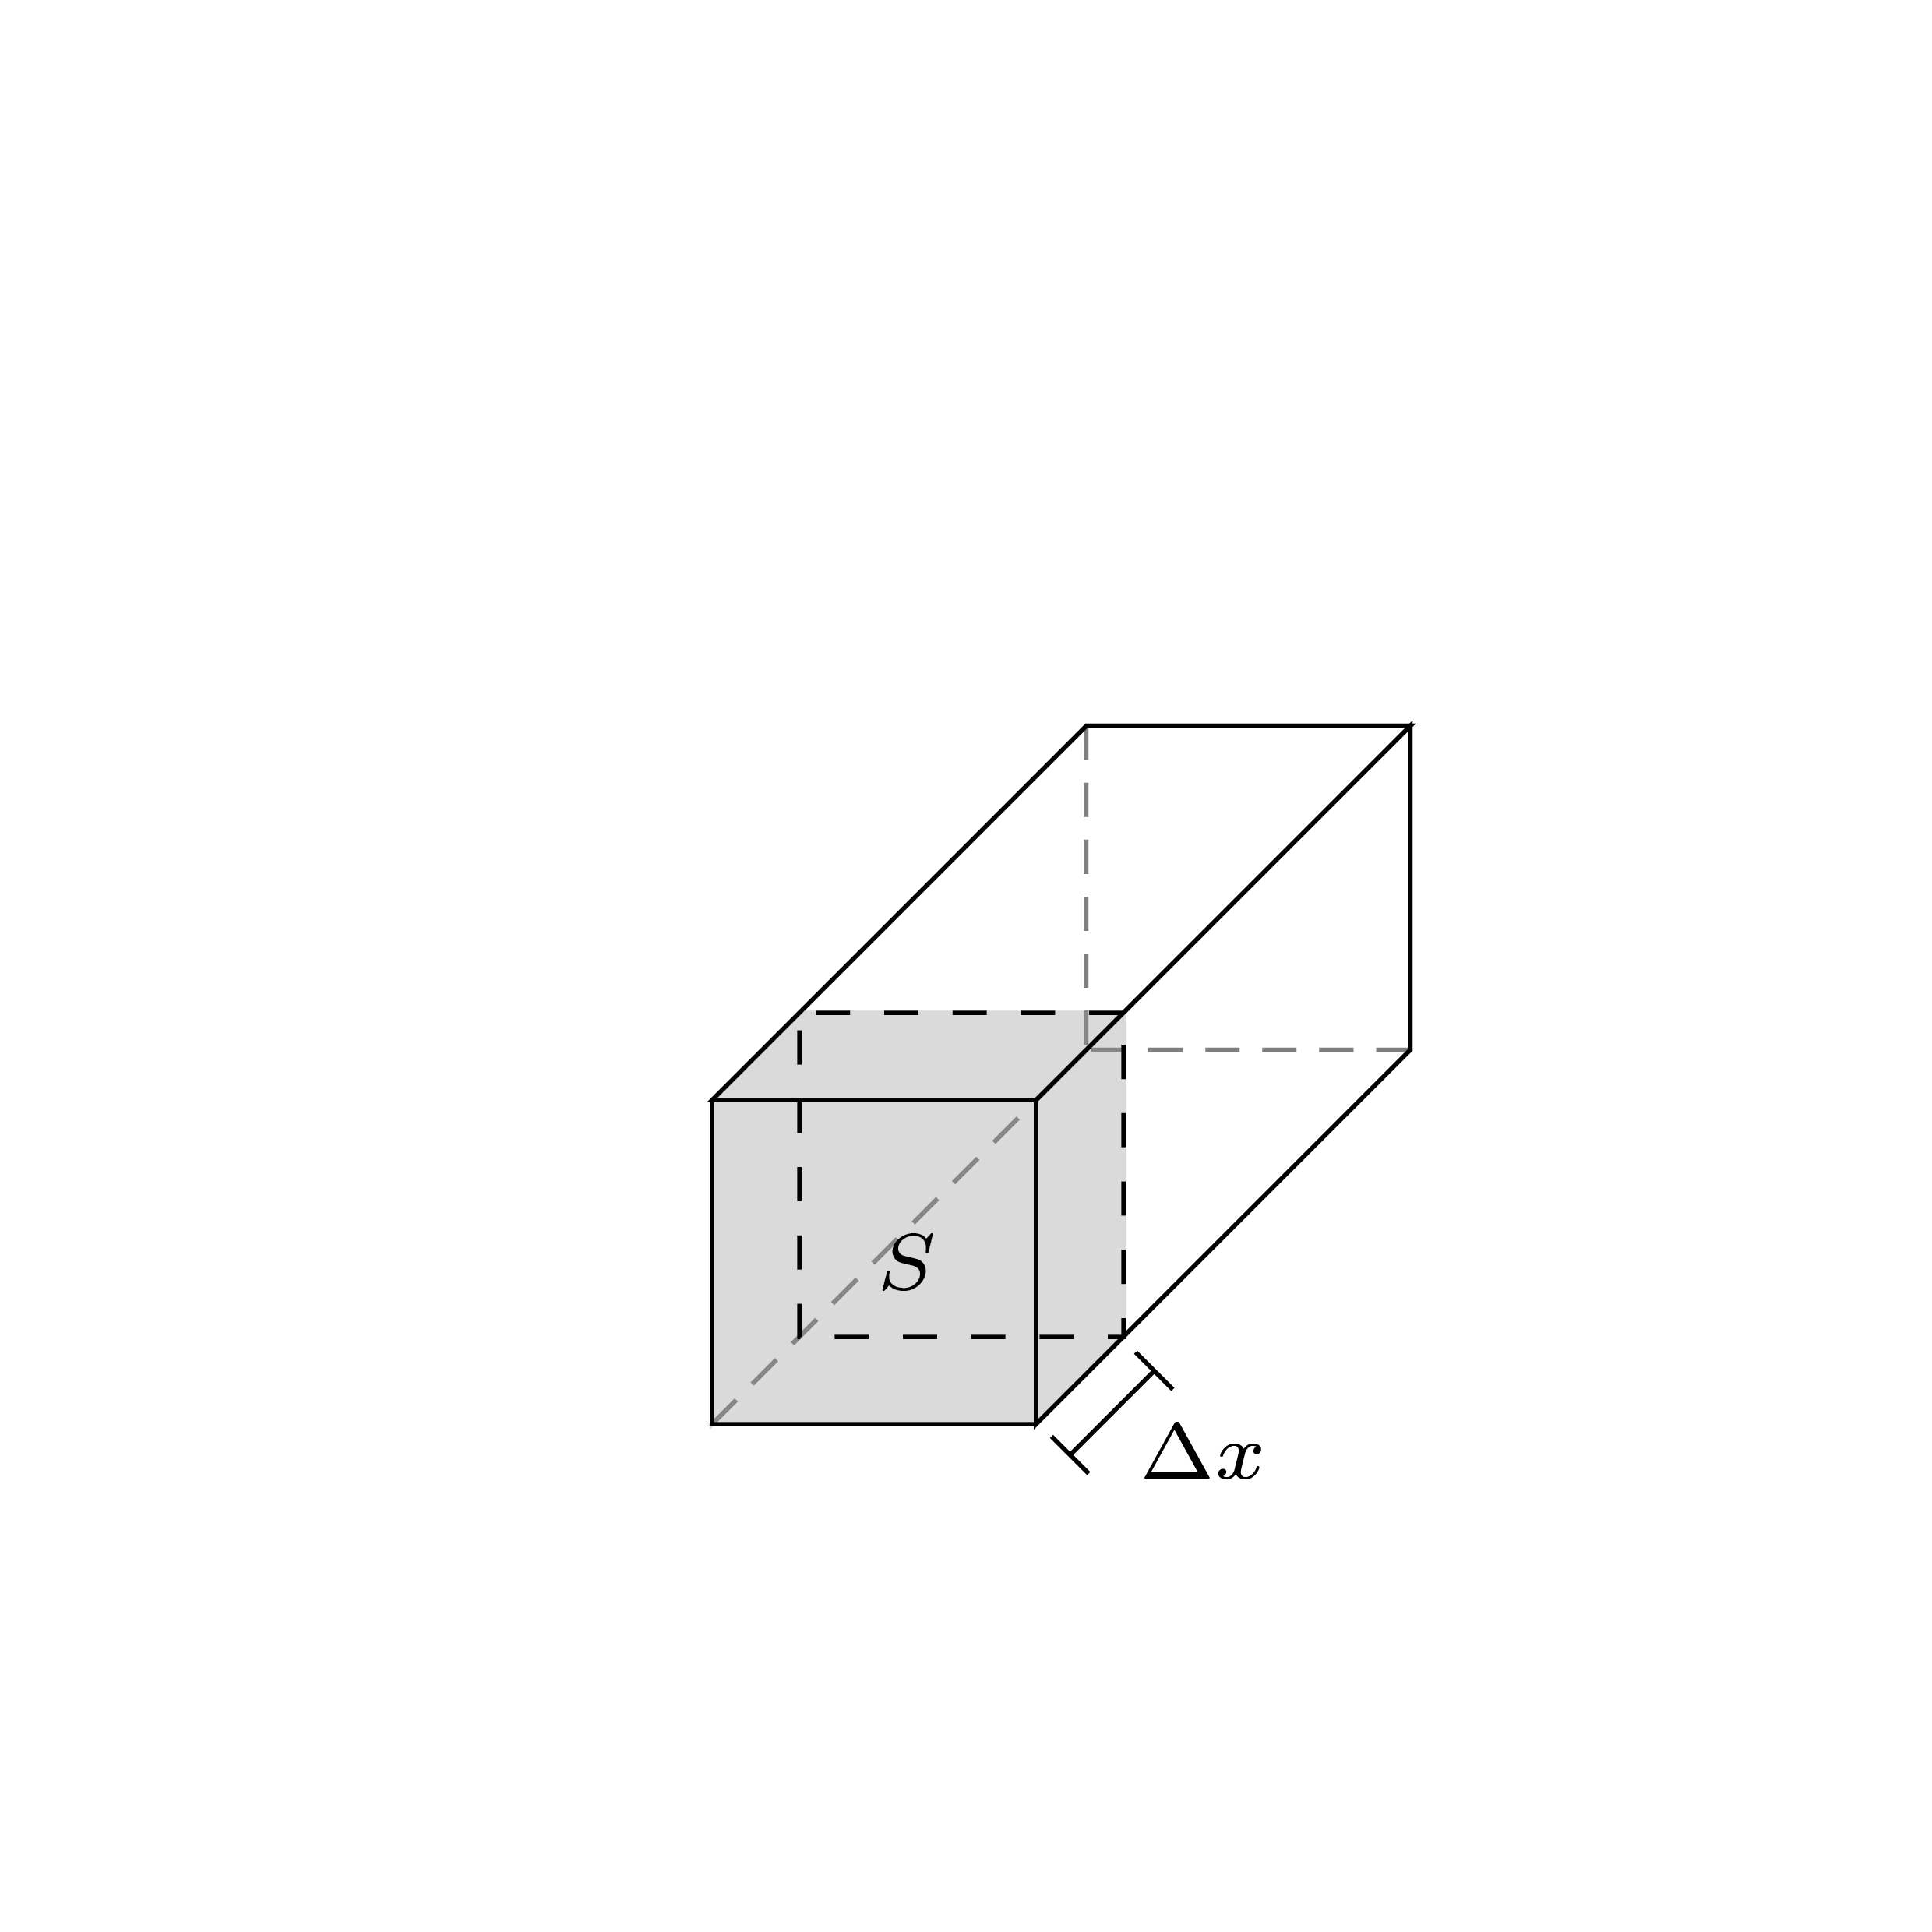
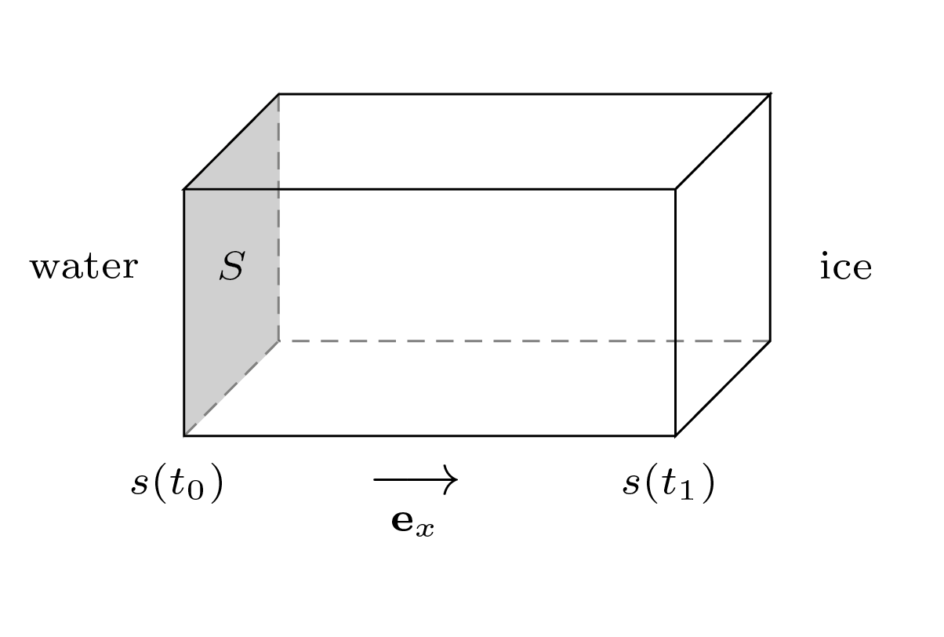


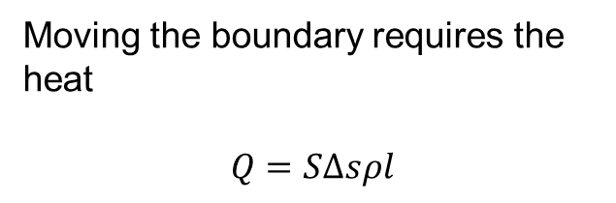
The one-phase Stefan problem
N walkers raise the temperature by 1°C.
One walker then carries the heat
$$Q=\frac{SΔxρc1°C}{N}$$
Moving the boundary requires the heat
$$Q=SΔsρl$$
$$Δs=\frac{c}{lN}Δx$$

Slide 36
Comparison between known analytical solution and RWM solution

Slide 37
Results using observed air temperatures as BC.
Note: Negative temperatures in water?

Slide 38
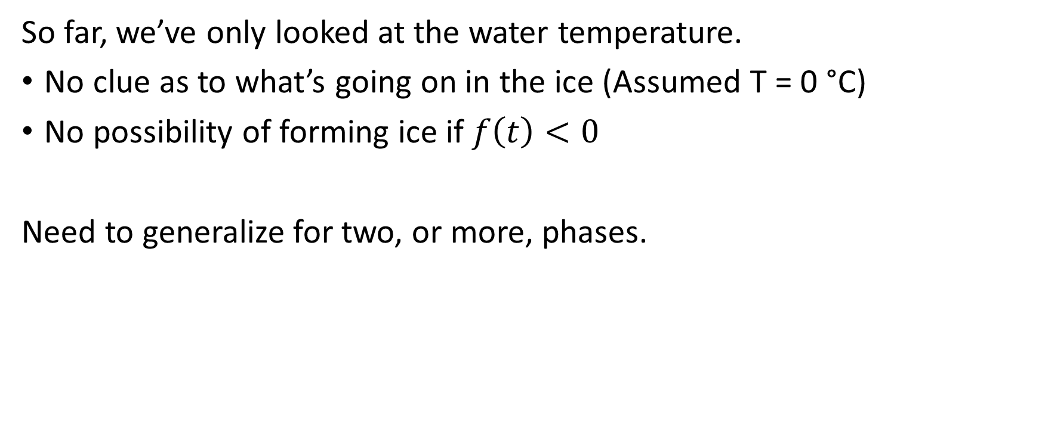
The two-phase Stefan problem
So far, we’ve only looked at the water temperature.
No clue as to what’s going on in the ice (Assumed T = 0 °C)
No possibility of forming ice if $f\left(t\right)<0$
Need to generalize for two, or more, phases.

Slide 39
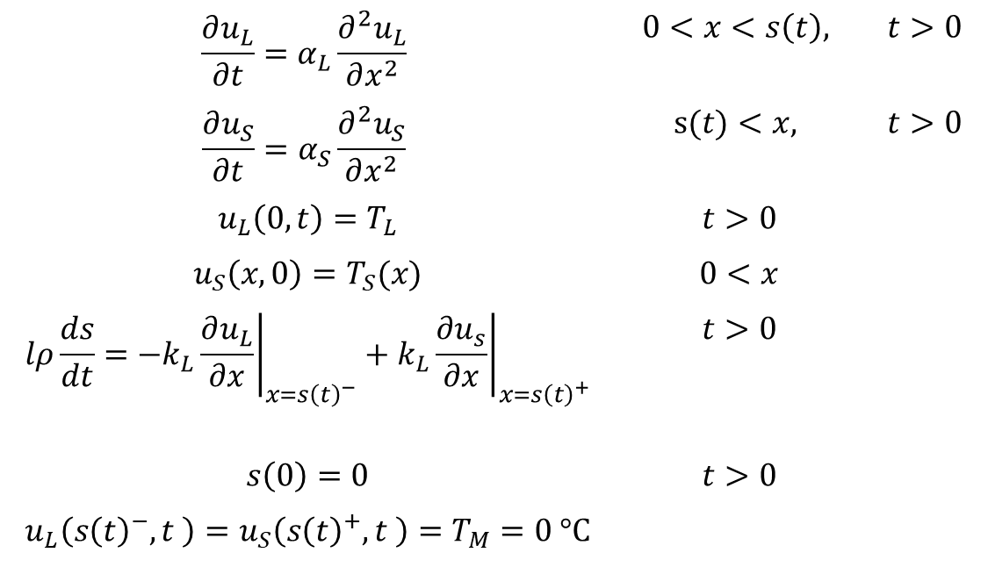
The two-phase Stefan problem
$$\frac{∂u_{L}}{∂t}=α_{L}\frac{∂^{2}u_{L}}{∂x^{2}}$$ | $$0<x<s\left(t\right),$$ | $$t>0$$
$$\frac{∂u_{S}}{∂t}=α_{S}\frac{∂^{2}u_{S}}{∂x^{2}}$$ | $$s(t)<x,$$ | $$t>0$$
$$u_{L}\left(0,t\right)=T_{L}$$ | $$t>0$$
$$u_{S}\left(x,0\right)=T_{S}(x)$$ | $$0<x$$
$$lρ\frac{ds}{dt}=−k_{L}{\left.\frac{∂u_{L}}{∂x}\right|}_{x=s{\left(t\right)}^{−}}+k_{L}{\left.\frac{∂u_{s}}{∂x}\right|}_{x=s{\left(t\right)}^{+}}$$ | $$t>0$$
$$s\left(0\right)=0$$ | $$t>0$$
$$u_{L}\left(s{\left(t\right)}^{−},t \right)=u_{S}\left(s{\left(t\right)}^{+},t \right)=T_{M}=0 °C$$

Slide 40
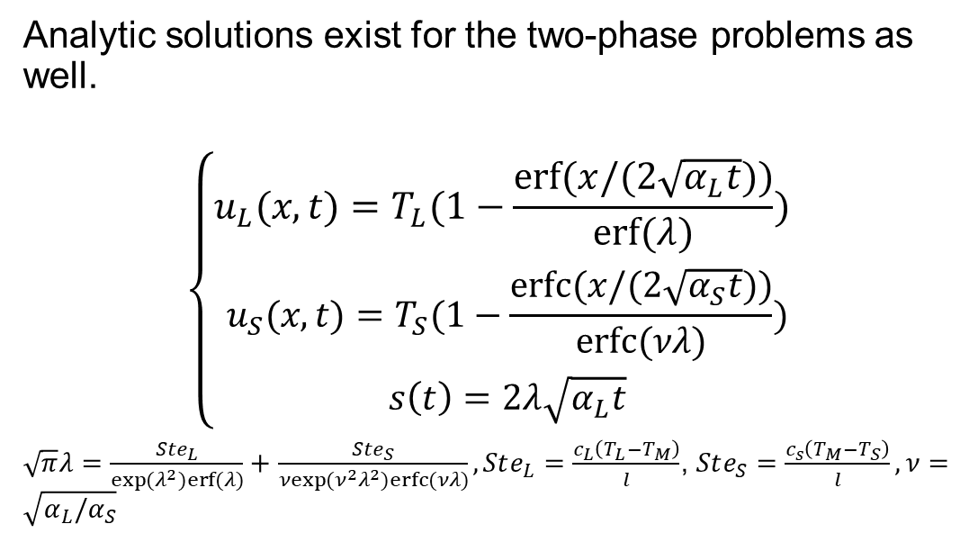
The two-phase Stefan problem
Analytic solutions exist for the two-phase problems as well.
$$\left\{\begin{aligned}u_{L}(x,t)=T_{L}(1−\frac{erf⁡(x/(2\sqrt{α_{L}t}))}{erf⁡(λ)}) \\ u_{S}(x,t)=T_{S}(1−\frac{erfc⁡(x/(2\sqrt{α_{S}t}))}{erfc⁡(νλ)}) \\ s\left(t\right)=2λ\sqrt{α_{L}t}\end{aligned}\right.$$
$\sqrt{π}λ=\frac{Ste_{L}}{\exp{(λ^{2})}erf⁡(λ)}+$ $\frac{Ste_{S}}{νexp{({ν^{2}λ}^{2})}erfc⁡(νλ)}, Ste_{L}=\frac{c_{L}\left(T_{L}−T_{M}\right)}{l}$, $Ste_{S}=\frac{c_{s}\left(T_{M}−T_{S}\right)}{l}, ν=\sqrt{α_{L}/α_{S}}$

Slide 41
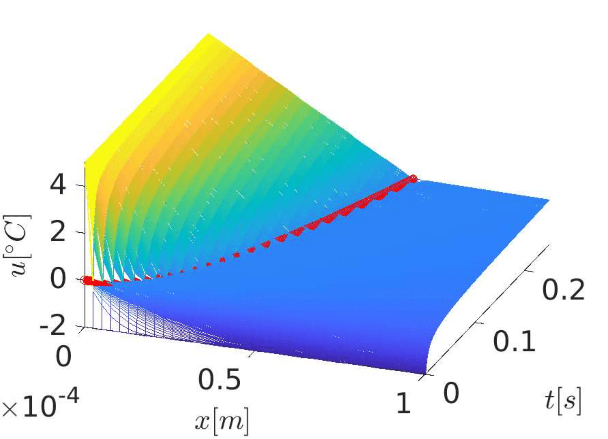
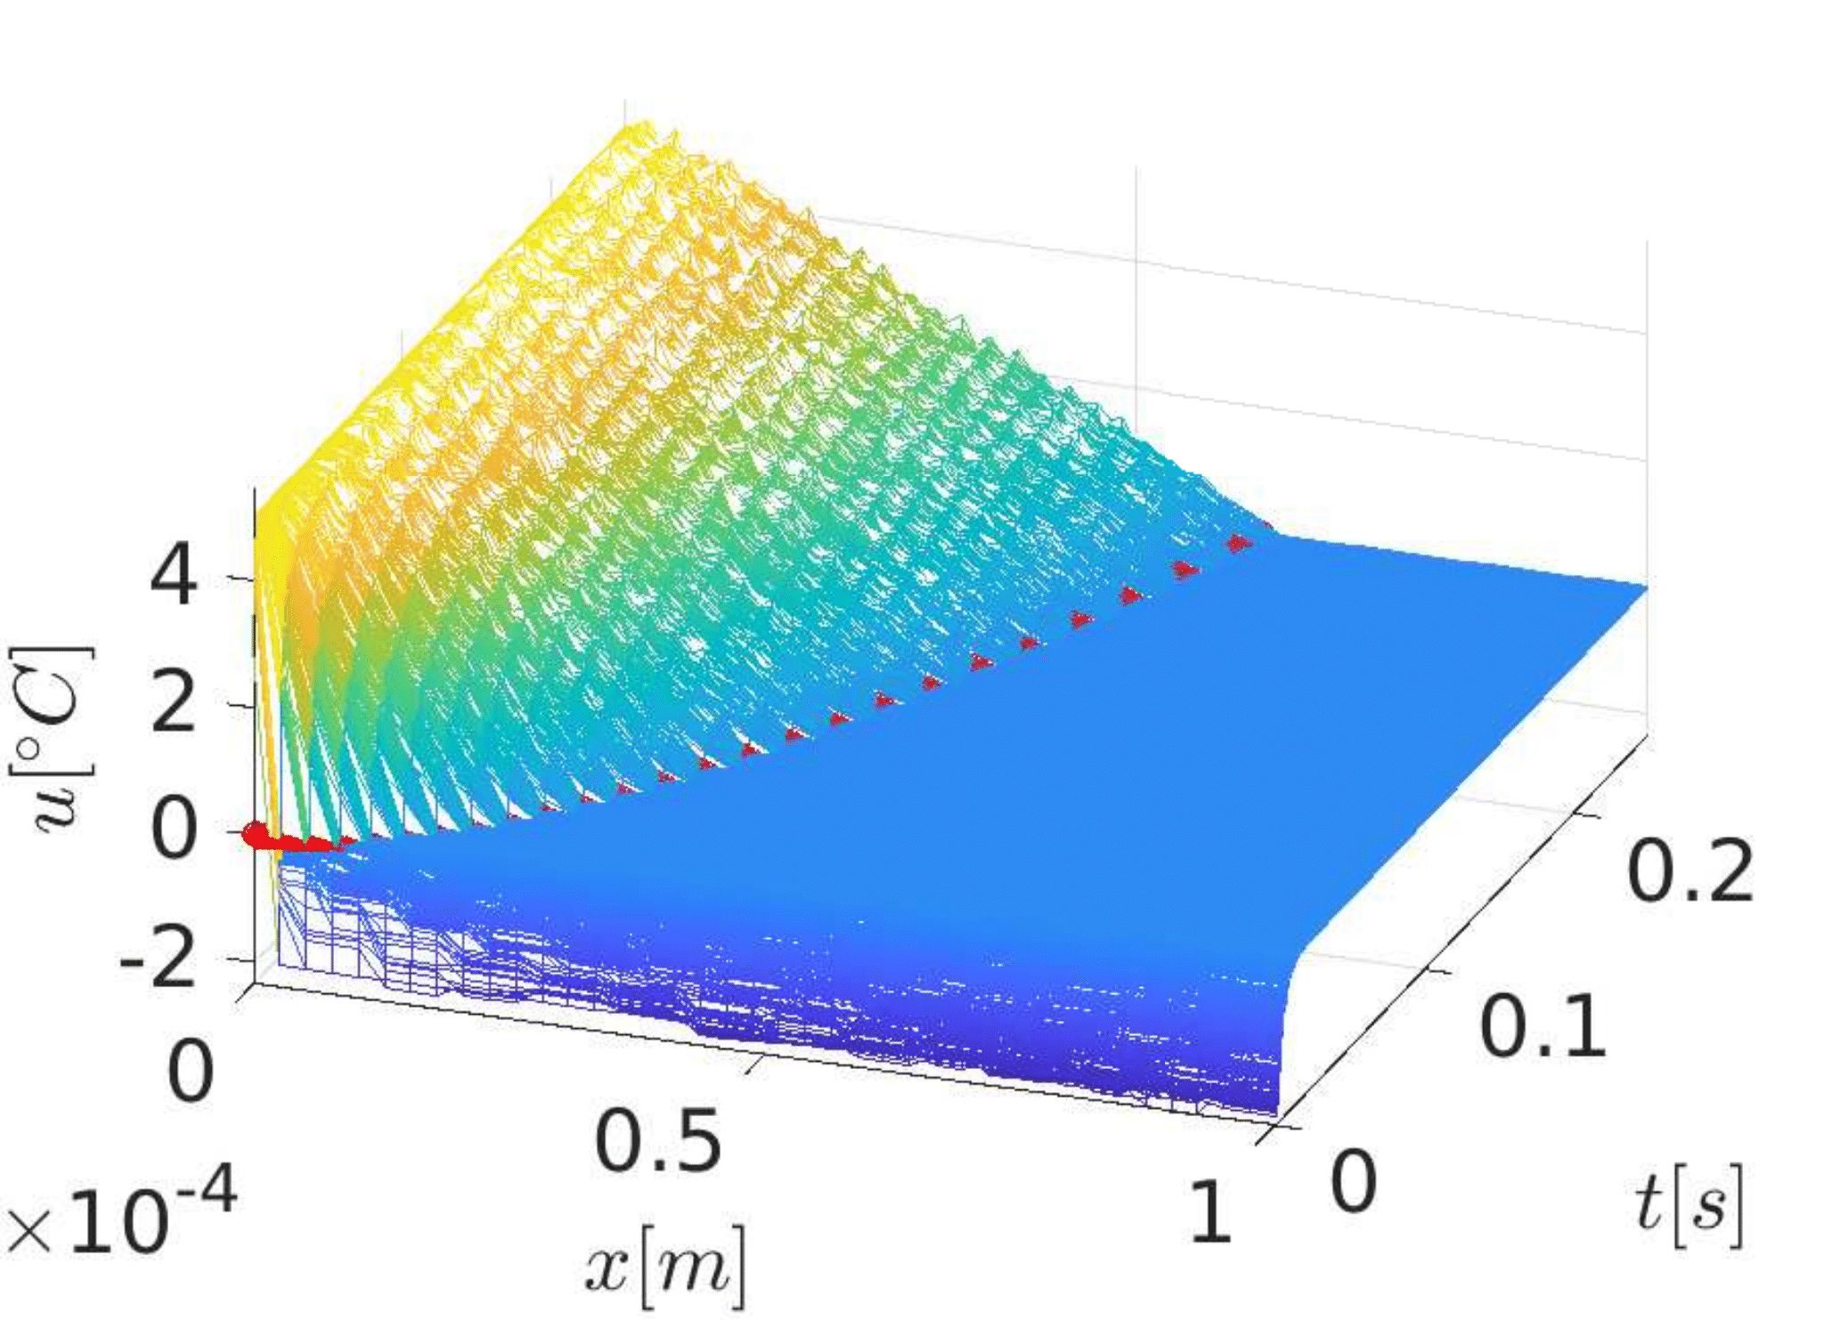

Slide 42
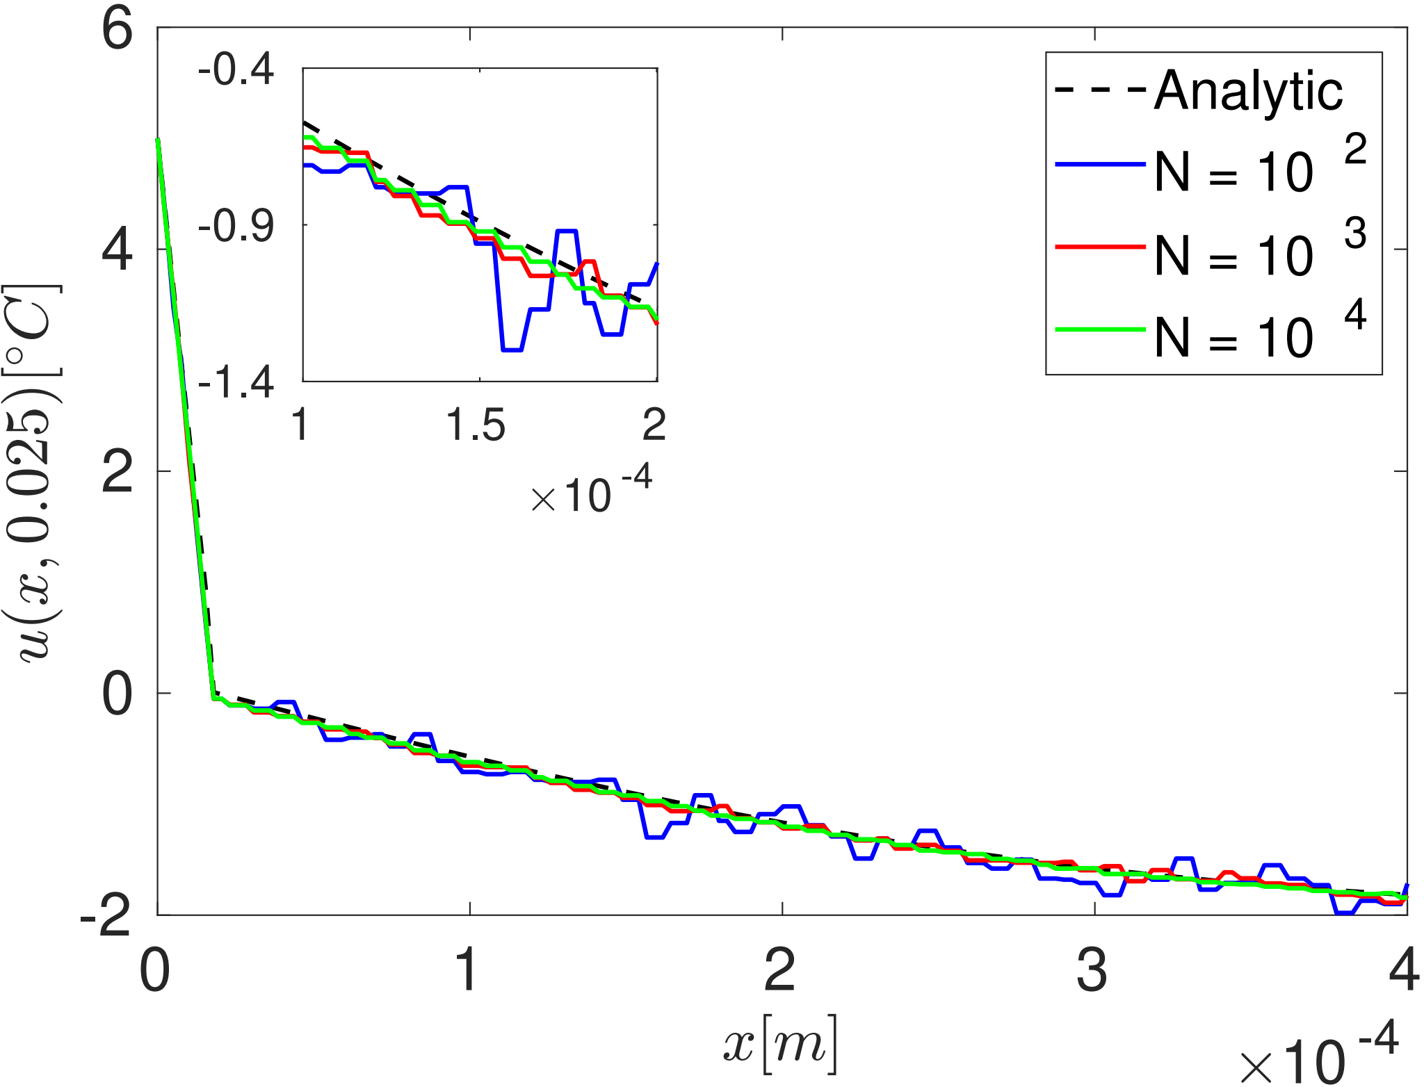

Slide 43
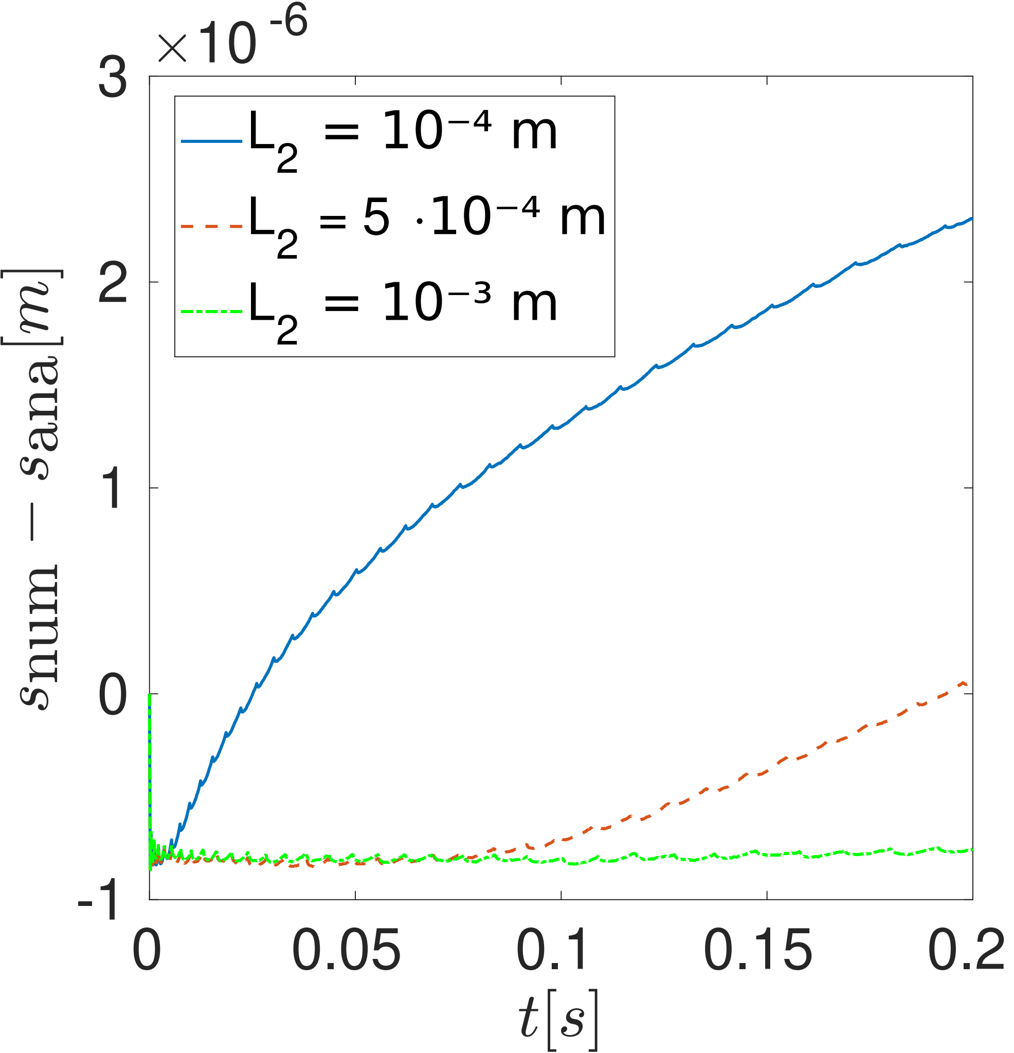
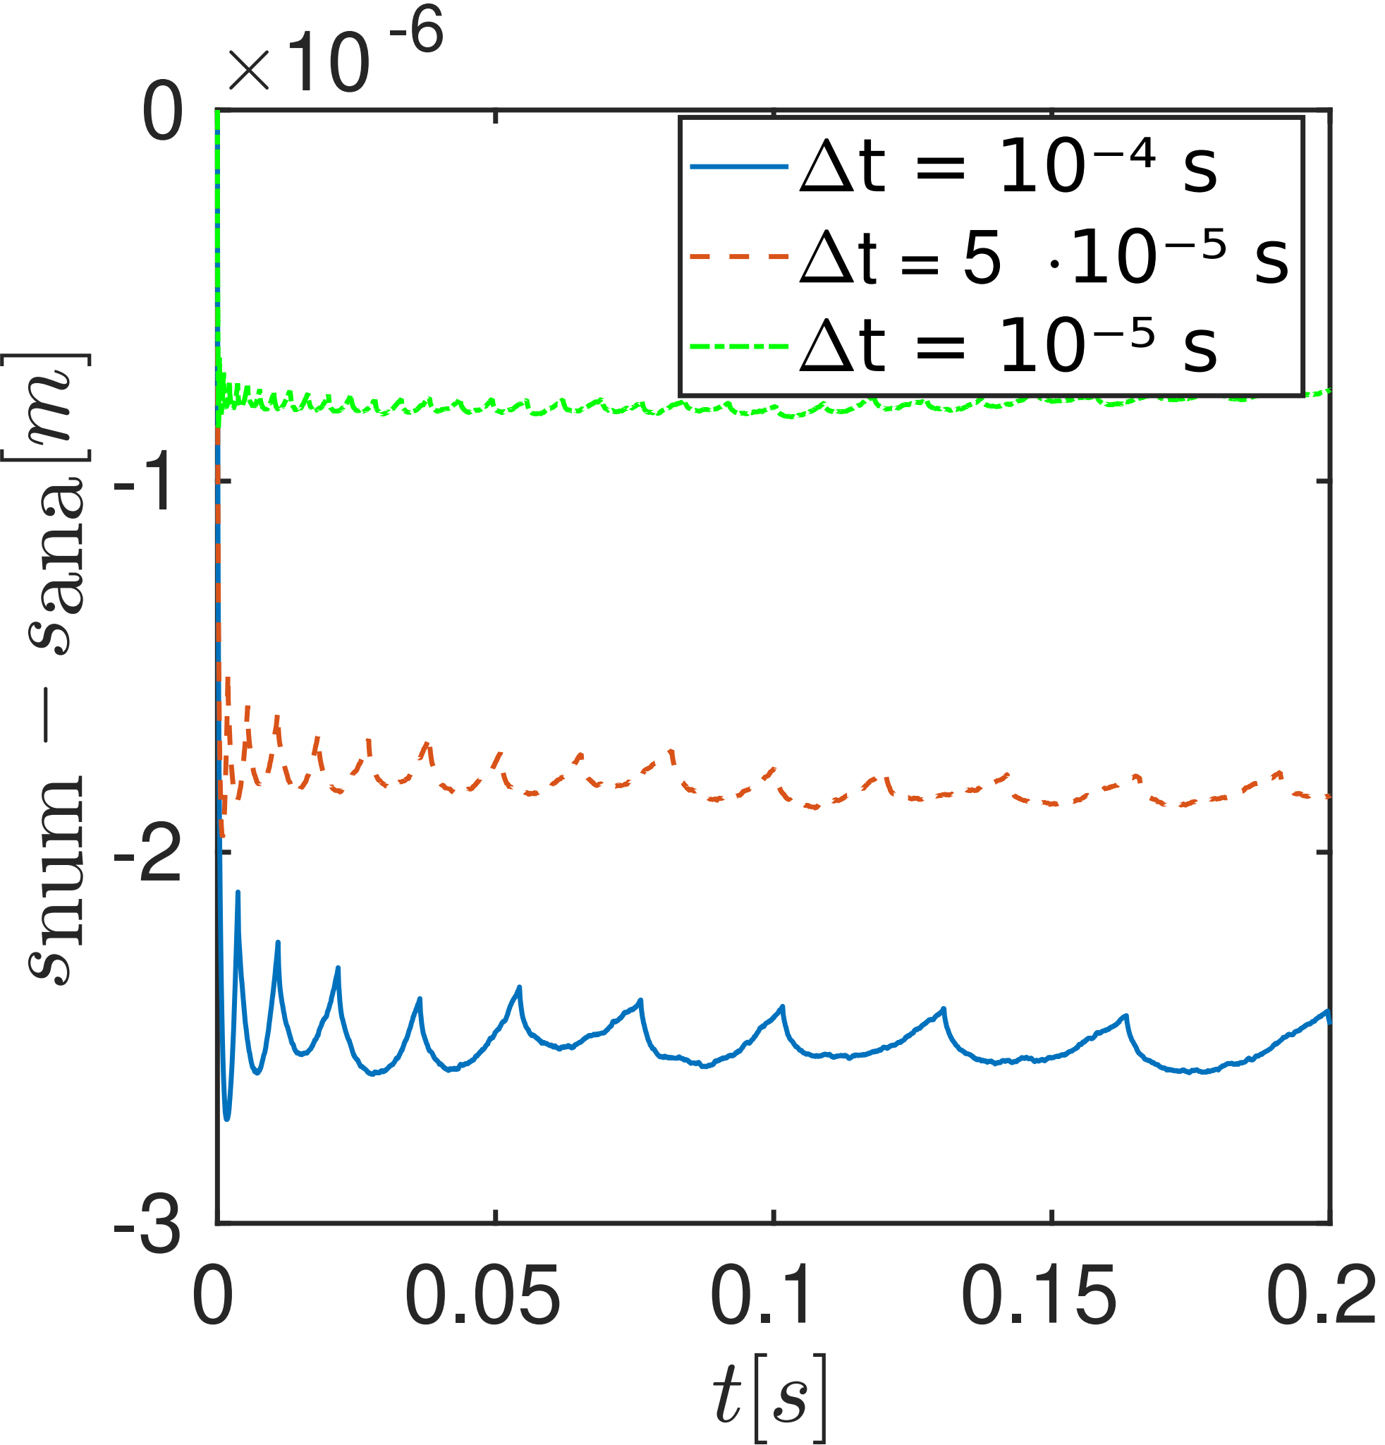

Slide 44
Possible extensions
Account for different densities of water and ice.
Consider multiple (variable number of) boundaries

Slide 45
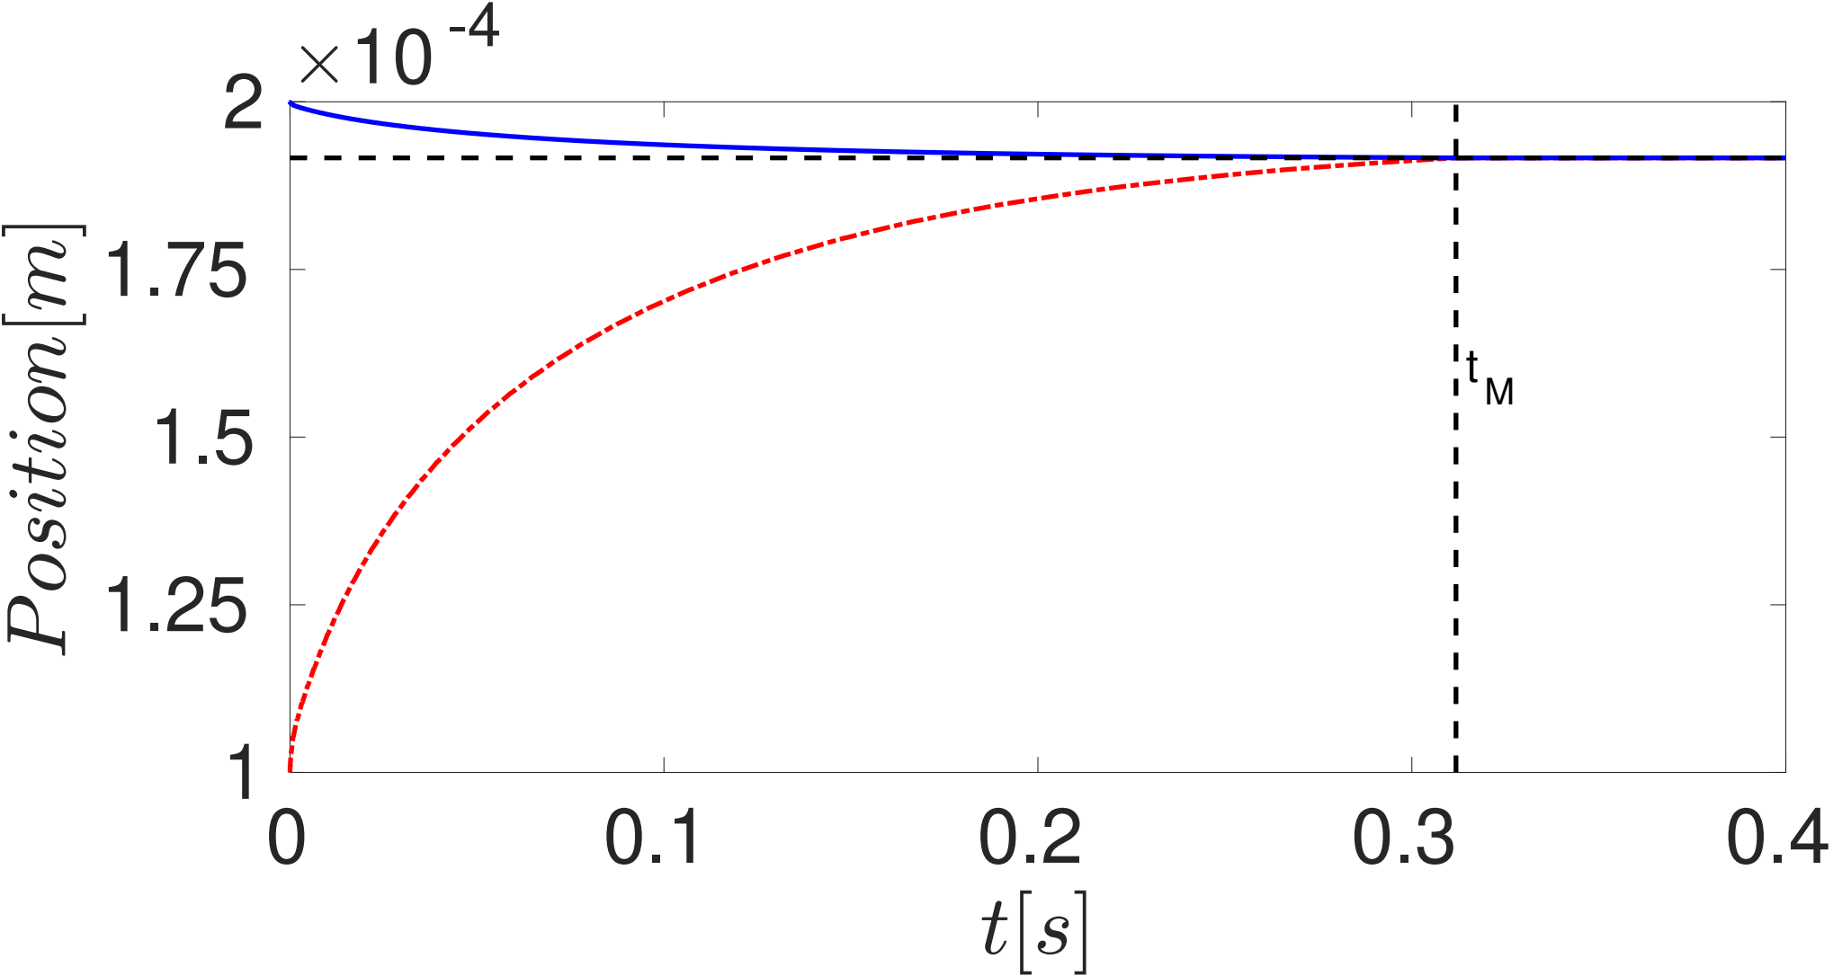
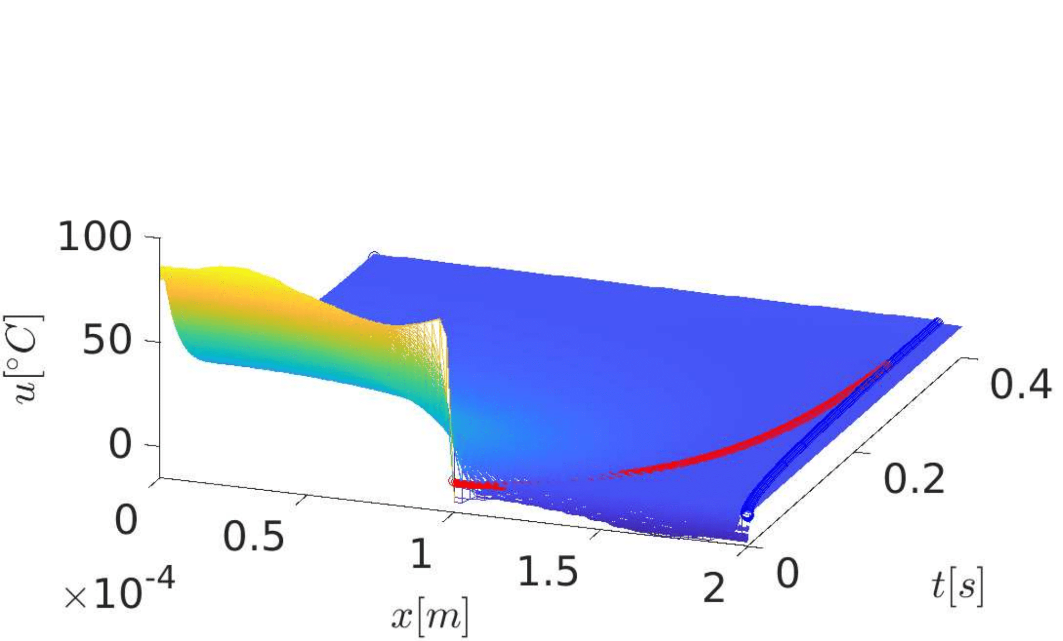
Non-equal densities, non-constant initial temperature

Slide 46
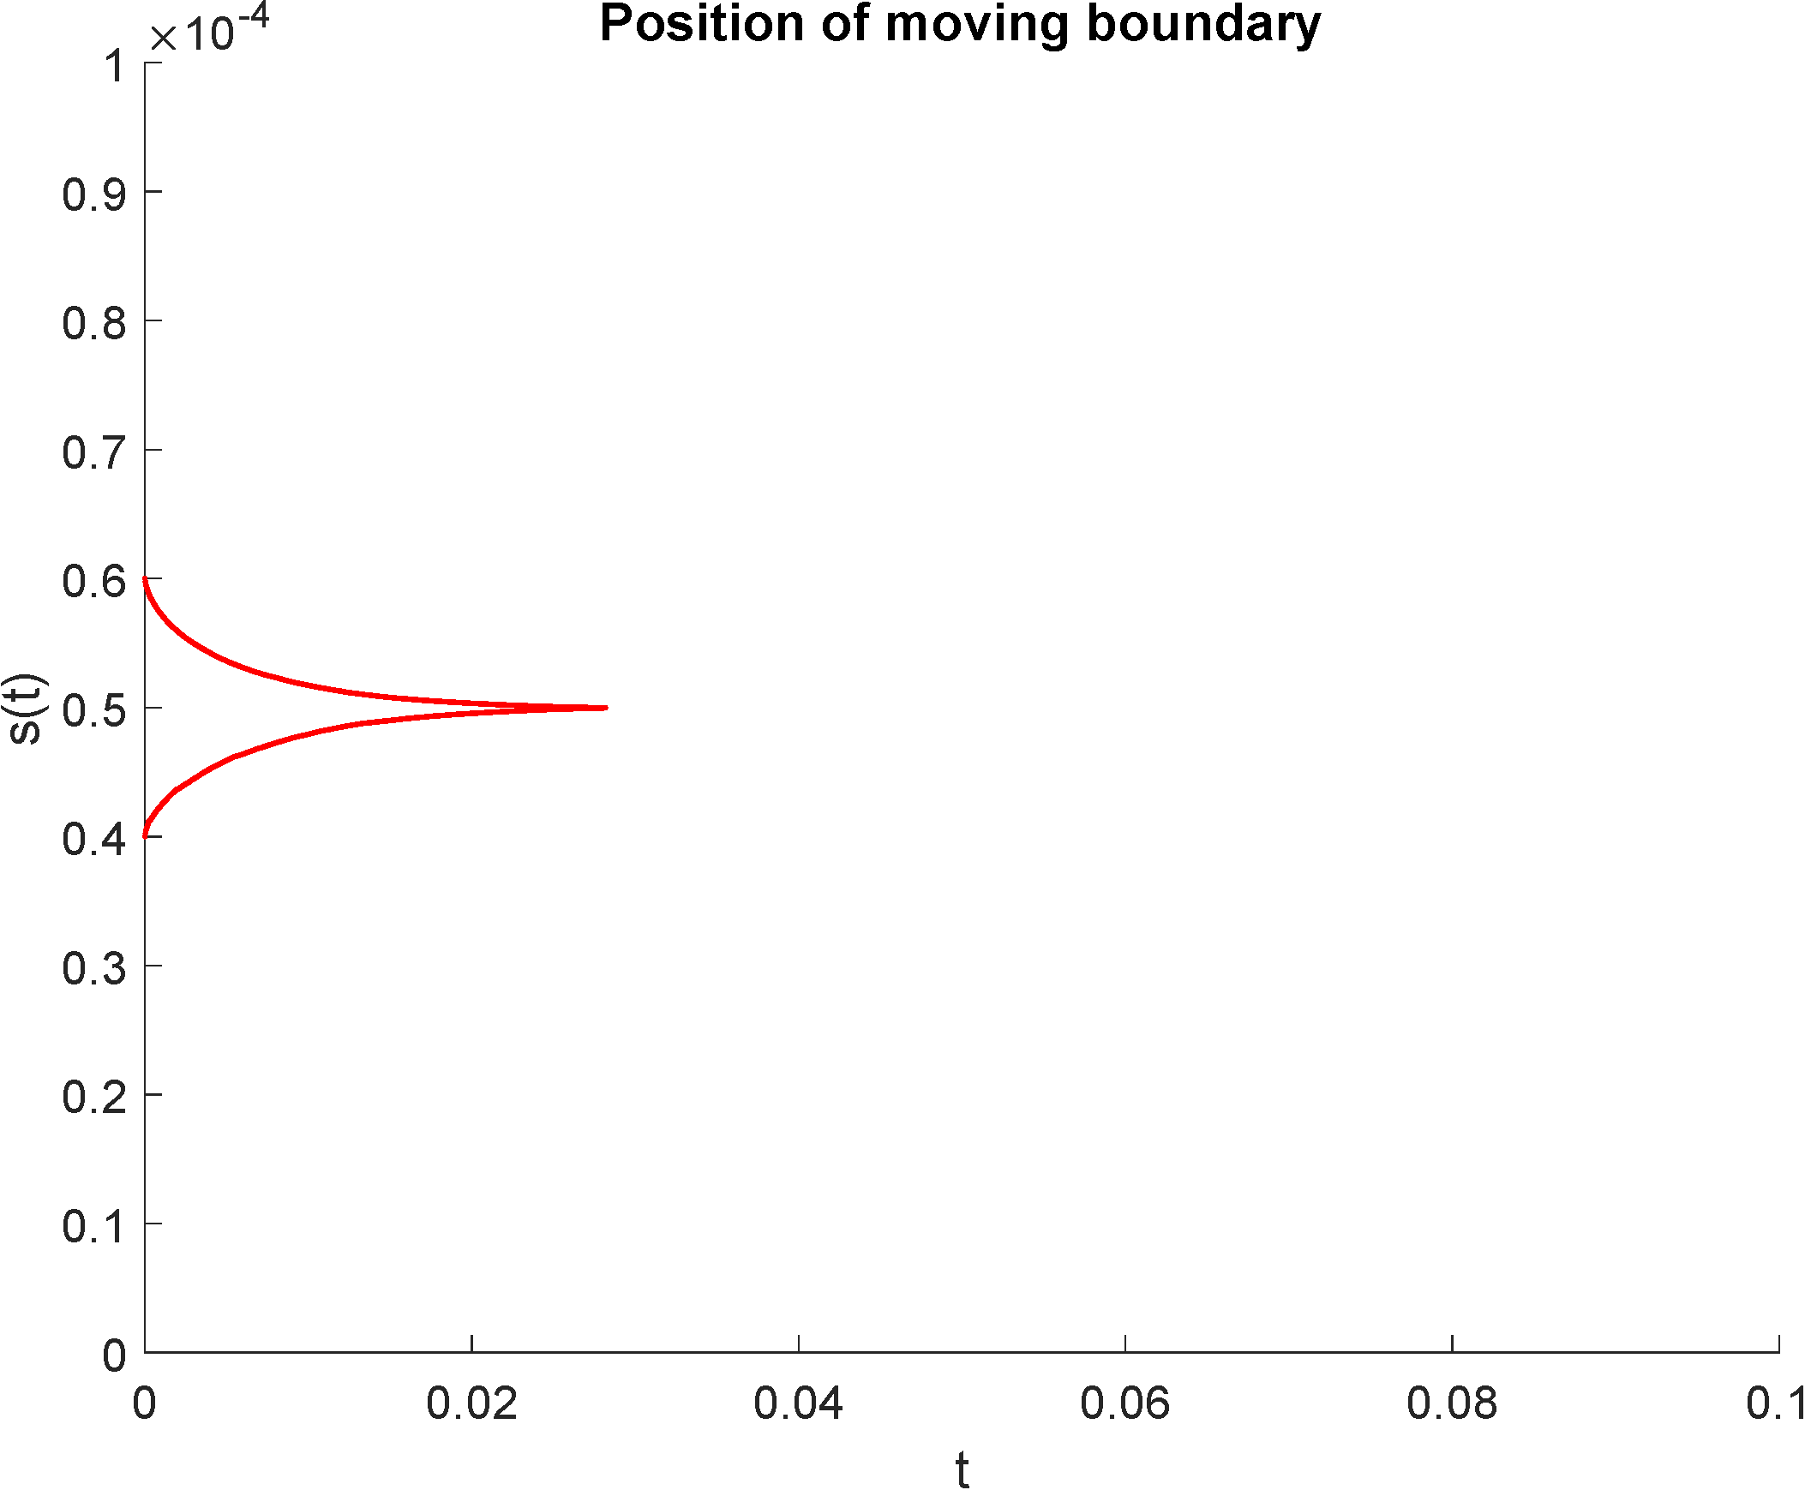
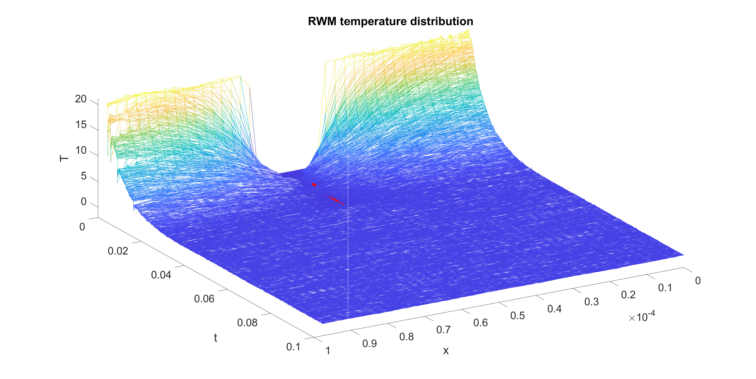
Three domains

Slide 47
The Stefan problem

Slide 49
The Stefan problem

Slide 50
The Stefan problem

Slide 52
The Stefan problem

Slide 53
Toy model, two bosonic modes [PRA 64, 025801 (2001)]

Slide 54
Toy model, two bosonic modes [PRA 64, 025801 (2001)]

Slide 59
Thank you!
Questions?

